Slide 1

AWS Cloud Computing
Unit 4: Database and Container Services
Amazon RDS | DynamoDB | ElastiCache | Database selection | Containers | ECR, ECS and EKS

Slide 2
Unit 4: Database and Container Services: Diagram
Unit roadmap - the data layer and the container layer come together in Part L.
Data layer
Container layer
Part B Amazon RDS
Part F Containerization (Docker)
Part G Amazon ECR
Part C Amazon DynamoDB
Part H Amazon ECS
Part D Amazon ElastiCache
Part I Amazon EKS
Part E Database selection
Part J-K Orchestration, best practices
Part L Real-world architecture (both layers together)
2
Notes:
PRESENTER NOTE
Open by linking back to earlier units: compute (EC2), storage (S3/EBS) and networking (VPC) are the building blocks. This unit adds the data layer and the modern way to package and run applications.

Slide 3
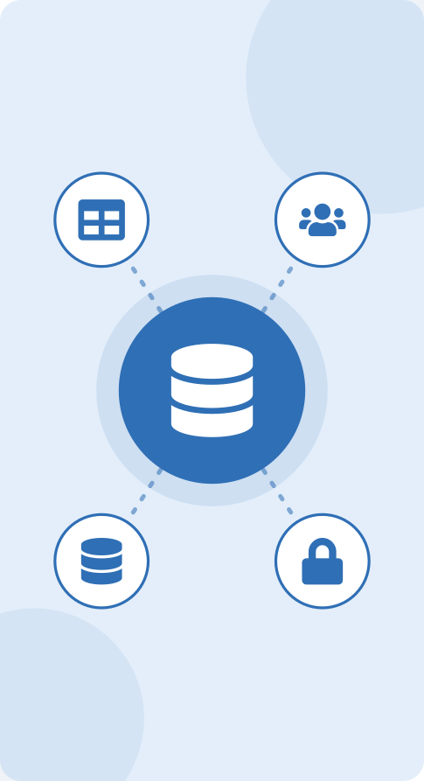
Part A
Database Fundamentals
In this part
What Is a Database?
Types of Databases
AWS Database Services
3

Slide 4

What Is a Database?
Purpose of a database
Keep data organised, durable and shareable
Let many users and applications use the same data safely
Storing and retrieving information
Create, Read, Update, Delete (CRUD)
Query by condition instead of searching files by hand
Examples
Student records - name, course, marks
Banking transactions - a debit or credit must never be lost
E-commerce products - catalogue, price, stock
Why applications need databases
Data must survive restarts and crashes (persistence)
Many users read and write at the same time (concurrency)
Rules keep data correct and protected (integrity, security)
Real-world scenario
A college portal has 5,000 students checking results at the same time while staff upload marks. A shared database lets everyone see consistent data; a spreadsheet on one PC cannot.
Important for exam / interview
Database = organised collection of data. DBMS = software that manages it (MySQL, PostgreSQL, DynamoDB engine).
Good cloud design keeps application servers stateless and stores state in a database, so servers can be added or replaced freely.
4

Slide 5
What Is a Database?: Diagram
Why a database beats a plain file.
Without a database
With a database
App
students.txt
App
DBMS
Organised data
No concurrency control
Slow search
Easy to corrupt
Indexes and transactions
Security
Backup and recovery built in
5

Slide 6
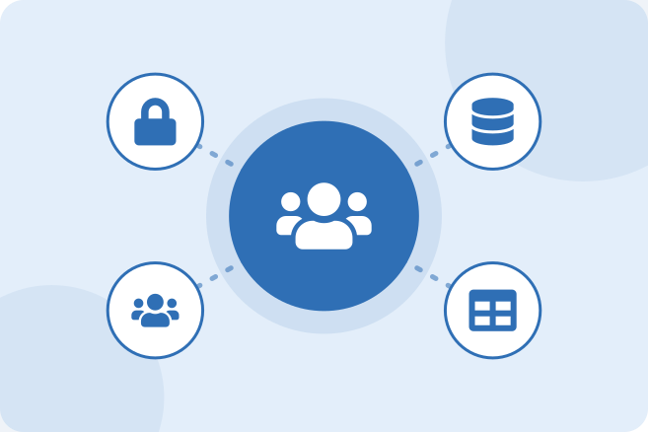
Types of Databases
Relational databases
Data in tables (rows and columns) with a fixed schema
Tables linked by keys and queried with SQL
NoSQL databases
Flexible models: key-value, document, wide-column, graph
Designed for scale-out and very low latency
Key differences
Schema, query style, scaling method, relationships
Simple examples of each
Relational: Students and Marks tables joined on StudentID
NoSQL: one JSON item per student, session or shopping cart
Important for exam / interview
NoSQL does not mean "no SQL at all" - it means "not only SQL".
Neither type is better; the choice depends on the data and the access pattern.
6

Slide 7
Types of Databases: Diagram
The same student data in both models.
Relational (Amazon RDS)
NoSQL (Amazon DynamoDB)
Students
Marks
ID | Name | Course
101 | Rahul | B.Tech
ID | Subject | Score
101 | Cloud | 88
{ "StudentID": 101,
"Name": "Rahul",
"Course": "B.Tech",
"Skills": ["Java","SQL"] }
SELECT s.Name, m.Score
FROM Students s
JOIN Marks m ON s.ID = m.ID;
One item, no join needed
GetItem(Key = { StudentID: 101 })
Two tables joined on the key
7

Slide 8
Relational vs NoSQL
Aspect | Relational | NoSQL
Data model | Tables, rows, columns | Key-value, document, wide-column, graph
Schema | Fixed, defined up front | Flexible per item
Relationships | JOINs and foreign keys | Usually denormalised; design around access patterns
Scaling | Bigger instance + read replicas | Horizontal scale-out by partitioning
Transactions | Strong ACID(Atomicity, Consistency, Isolation and Durability) support | Varies by product (DynamoDB offers transactions)
Best for | Banking, ERP, structured business data | Huge scale, flexible data, millisecond latency
8

Slide 9
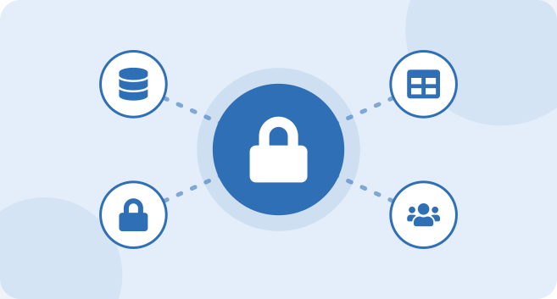
AWS Database Services
Amazon RDS
Amazon DynamoDB
Amazon ElastiCache
When different database types are useful
Structured data with relationships: RDS
Massive scale, simple access by key: DynamoDB
Speed for hot data: ElastiCache
Important for exam / interview
AWS offers purpose-built databases: pick the service that matches the data model and access pattern.
Amazon Redshift is a data warehouse for analytics, not a transactional (OLTP) database.
9

Slide 10
The three core services of this unit
Service | Type | Typical use
Amazon RDS | Managed relational (SQL) | Business apps, websites, ERP/CRM, reporting
Amazon DynamoDB | Managed NoSQL (key-value/document) | Shopping carts, gaming, IoT, mobile back ends
Amazon ElastiCache | Managed in-memory cache | Caching hot data, sessions, leaderboards
Also exist (awareness only) | Aurora, Redshift, DocumentDB, Neptune, MemoryDB | Cloud-native SQL, data warehouse, MongoDB-compatible, graph, durable in-memory
10

Slide 11
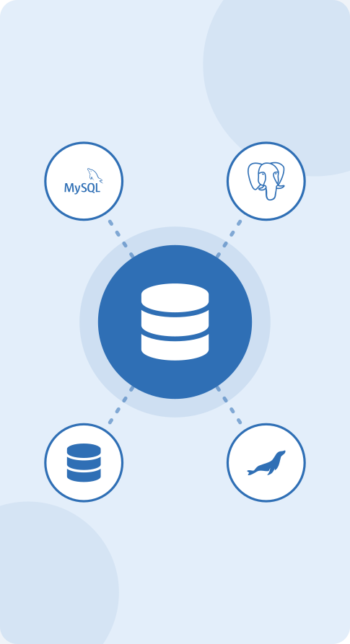
Part B
Amazon RDS
In this part
What Is Amazon RDS?
RDS Database Engines
Basic RDS Architecture
RDS Storage
RDS Backup
RDS Security
Multi-AZ Deployment
Why Use Multi-AZ?
Read Replicas
Multi-AZ vs Read Replica
RDS Example
11

Slide 12
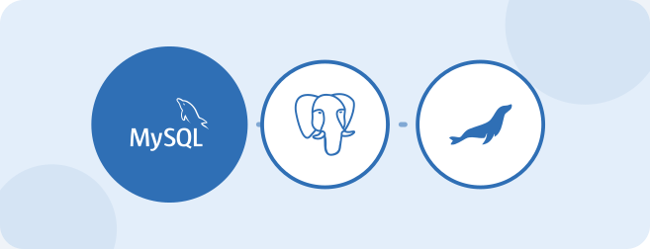
What Is Amazon RDS?
Managed relational database service
Relational Database Service - run SQL databases without managing servers
AWS manages much of the infrastructure
Hardware, OS, database software install and patching, backups, failover
Applications connect to the database over a network
Connect through an endpoint (DNS name) and a port
Reduces database administration work
Teams focus on schema, queries and application logic
Real-world scenario
A small start-up used to run MySQL on one EC2 instance and spent weekends patching and restoring backups. After moving to RDS, patching and backups became settings in the console.
Important for exam / interview
You cannot SSH into an RDS host. (RDS Custom for Oracle/SQL Server is the exception.)
RDS is not serverless: you choose an instance class and storage. Aurora Serverless is the serverless variant.
12

Slide 13
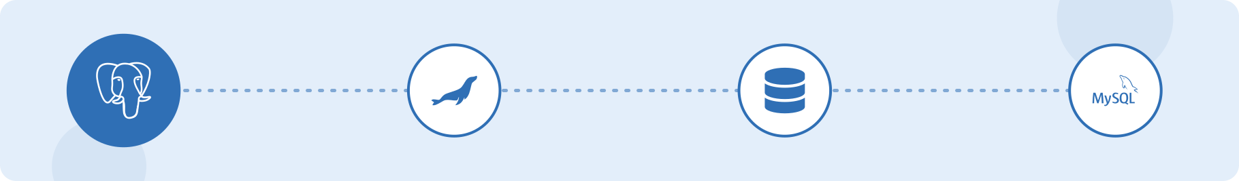
Shared responsibility in RDS
AWS manages | You manage
Physical hardware, power, networking | Schema design, tables, indexes, queries
Operating system and patching | Database users and permissions
Database engine installation and minor patching | Security group rules and network placement
Automated backups, failover (Multi-AZ), monitoring hooks | Instance size, storage choice, parameter tuning
13

Slide 14
Why Use Amazon RDS?
Amazon RDS is a managed relational database service that sets up, operates and scales databases in the cloud, so you run databases without managing servers.
Managed administration
AWS handles hardware, OS and engine patching, backups and monitoring, so teams focus on data and applications.
High availability
Multi-AZ keeps a standby copy in another Availability Zone and fails over automatically.
Scalability
Resize the instance, let storage autoscale and add read replicas as demand grows.
Security
Runs in a VPC with security groups, encryption at rest and in transit, and IAM controls.
Cost-effective
Pay as you go for instance hours and storage; no hardware to buy or maintain.
Engine choice
MySQL, PostgreSQL, MariaDB, Oracle, SQL Server and Aurora, so existing applications move easily.
Used for: web and mobile back ends, e-commerce orders, ERP and CRM, and other structured business data.
14
Notes:
Amazon RDS (Relational Database Service) is a managed service that sets up, operates and scales relational (SQL) databases in the AWS cloud. It supports MySQL, PostgreSQL, MariaDB, Oracle, Microsoft SQL Server and Amazon Aurora. It is used in cloud environments because: AWS handles hardware, operating system and database patching, backups and monitoring, so administration effort falls; Multi-AZ deployments give automatic failover for high availability; storage and instance size can be scaled and read replicas added as demand grows; it runs inside a VPC with security groups, encryption and IAM for security; and it is pay-as-you-go with no hardware to buy. Typical uses are web and mobile back ends, e-commerce orders, ERP and CRM and other structured business data.

Slide 15
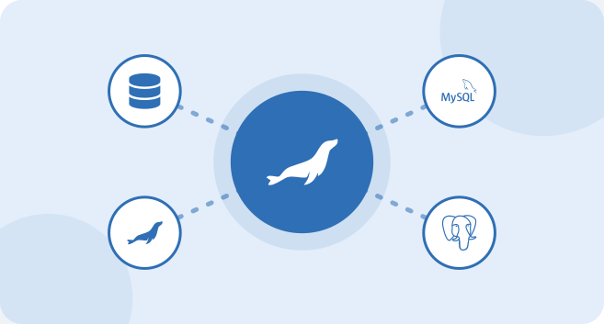
RDS Database Engines
MySQL
PostgreSQL
MariaDB
Oracle
Microsoft SQL Server
Amazon Aurora
Choosing an engine based on application requirements
Compatibility with existing code and tools
Licensing cost and features needed
Important for exam / interview
Aurora is part of the RDS family but has its own cluster architecture and storage layer.
Migrating an existing Oracle or SQL Server application: keep the same engine to avoid rewriting code.
15

Slide 16
Engines at a glance
Engine | Default port | Notes
MySQL | 3306 | Popular open source, widely used for web apps
PostgreSQL | 5432 | Advanced SQL features, extensions, strong standards support
MariaDB | 3306 | Community fork of MySQL
Oracle | 1521 | Commercial; License Included or Bring Your Own License
SQL Server | 1433 | Microsoft ecosystem and .NET applications
Amazon Aurora | 3306 / 5432 | AWS-built, MySQL- and PostgreSQL-compatible; storage replicated across 3 AZs; up to 15 replicas
16

Slide 17
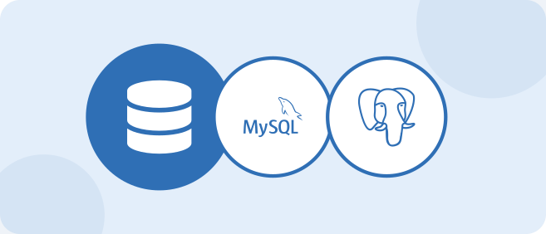
Basic RDS Architecture
User
Application
Amazon RDS
Database
Application sends SQL queries
RDS processes the request
Database stores application data
Real-world scenario
The college web app on EC2 reads student data from RDS. The database is in a private subnet, so students on the internet can reach the website but never the database directly.
Important for exam / interview
A DB subnet group must span at least two AZs, even for a single-AZ instance.
The endpoint is a DNS name, never hard-code an IP address.
17
Notes:
CONSOLE STEPS
Open the AWS Console and go to RDS, then choose Create database.
Choose Standard create, select the engine (for example MySQL) and a Free tier or Dev/Test template.
Enter a DB instance identifier, a master username and manage credentials (Secrets Manager or self-managed).
Choose an instance class such as db.t3.micro or db.t4g.micro.
Storage: General Purpose SSD (gp3), 20 GiB; tick Enable storage autoscaling if needed.
Connectivity: select the VPC and DB subnet group, set Public access to No and choose a VPC security group.
Additional configuration: set an initial database name, backup retention and encryption.
Click Create database and wait until the status is Available, then copy the endpoint.
HANDS-ON LAB
Lab 1 - Create a free-tier RDS MySQL instance, connect from an EC2 instance with the mysql client, create a Students table and insert two rows. Delete the database afterwards.

Slide 18
Basic RDS Architecture: Diagram
Logical flow (as in the slide) followed by the recommended network layout.
Logical flow
Recommended layout inside a VPC
User
Internet
Load Balancer
public subnet
Application
App servers
private subnet
Amazon RDS
port 3306, only from the app security group
RDS instance
private DB subnet group, no public access
Database
18

Slide 19
RDS Storage
Database storage
Storage capacity
Different storage types
Performance considerations
Storage expansion
Real-world scenario
A marks database that was 100 GiB at launch grows every semester. Storage autoscaling raises the size automatically instead of the system going read-only at night.
Important for exam / interview
Storage can be increased but cannot be decreased. To shrink, restore or migrate to a new, smaller instance.
Storage autoscaling needs a maximum storage threshold; it triggers when free space is very low (under 10%).
A storage modification has a cool-down of about 6 hours before the next one.
19
Notes:
TROUBLESHOOTING
Database status "storage-full" | Disk is full, writes fail | Increase allocated storage, enable autoscaling, delete old data
Slow queries during exports | IOPS limit reached | Move to gp3 with higher IOPS or Provisioned IOPS

Slide 20
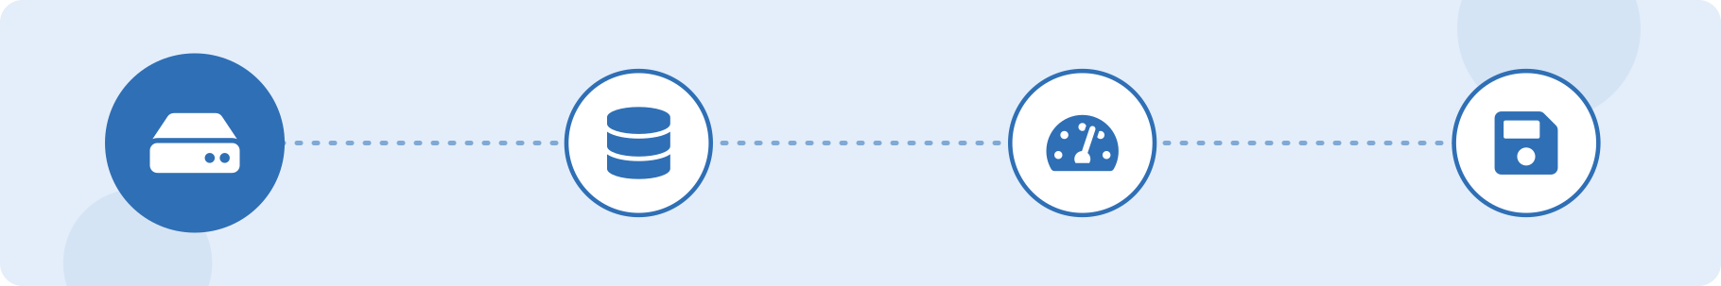
RDS storage types
Type | Use | Notes
General Purpose SSD (gp3 / gp2) | Most workloads | Balanced price and performance; gp3 sets IOPS independently of size
Provisioned IOPS SSD (io1 / io2) | I/O-intensive production databases | Consistent high IOPS; costs more
Magnetic (legacy) | Not recommended | Kept only for backward compatibility
20

Slide 21

RDS Security
VPC
Security Groups
Encryption
Database credentials
Access control
Real-world scenario
The development team once opened port 3306 to 0.0.0.0/0 for a quick test. A security review changed the rule to allow only the app-server security group.
Important for exam / interview
You cannot directly encrypt an existing unencrypted instance: snapshot, copy the snapshot with encryption, restore.
Security groups are stateful and allow rules only; reference another security group instead of IP ranges.
21
Notes:
TROUBLESHOOTING
Cannot connect to the database | Security group, subnet route, public access setting, wrong endpoint/port, or credentials | Check in order: status Available, endpoint and port, security group inbound rule, public access/route, network ACL, username and password, client firewall

Slide 22

RDS Backup
Automated backups
Daily snapshot plus transaction logs
Retention period 1 to 35 days (0 disables)
Manual snapshots
Taken on demand and kept until you delete them
Can be copied or shared across Regions/accounts
Point-in-time recovery
Restore to any second within the retention period
Why backups are important
Protect against deletion, corruption and bad deployments
Real-world scenario
A staff member runs DELETE without a WHERE clause at 11:42. The team restores to 11:40 and copies the missing rows back into the live database.
Important for exam / interview
Restore always creates a NEW DB instance with a new endpoint; it never overwrites the original.
Deleting a DB instance deletes its automated backups unless you choose to retain them; manual snapshots stay.
Multi-AZ is not a backup: a bad DELETE is copied to the standby immediately.
22
Notes:
CONSOLE STEPS
RDS console, select the database, choose Actions, then Take snapshot, and name it.
To restore a snapshot: Snapshots, select it, Actions, Restore snapshot, enter a new instance identifier.
For point-in-time recovery: select the DB, Actions, Restore to point in time, pick the time, name the new instance.
Check connectivity settings (VPC, security group, parameter group) on the restored instance.
TROUBLESHOOTING
Restored database not reachable | New instance uses default security group or parameter group | Select correct security group, subnet group and parameter group; update the application endpoint

Slide 23
Defence in depth
Layer | Control
Network | Private subnets, DB subnet group, Public access = No, security group allowing the DB port only from the application security group, network ACLs
Identity | IAM policies for who can manage RDS; IAM database authentication for MySQL/PostgreSQL
Encryption at rest | AWS KMS (AES-256) chosen when the database is created; covers storage, backups, snapshots, replicas
Encryption in transit | SSL/TLS between application and database
Credentials | AWS Secrets Manager with automatic rotation; never hard-code passwords
23

Slide 24

Multi-AZ Deployment
Meaning of Availability Zone
One or more isolated data centres inside an AWS Region with independent power and networking
Primary database
Handles all reads and writes
Standby database
Kept in another AZ by synchronous replication
Automatic failover
AWS promotes the standby and updates the DNS endpoint
Real-world scenario
Results are published on a single day and the college cannot afford downtime. Multi-AZ keeps the database available even if one data centre fails.
Important for exam / interview
In the standard Multi-AZ instance deployment the standby cannot serve read traffic.
Replication is synchronous; failover usually takes 1-2 minutes.
Multi-AZ DB clusters (MySQL/PostgreSQL) use two readable standbys and are a newer option.
24
Notes:
CONSOLE STEPS
RDS console, select the DB instance, click Modify.
Under Availability and durability, choose Create a standby instance (Multi-AZ).
Choose Apply immediately (or the next maintenance window) and click Modify DB instance.
Test failover: Actions, Reboot, tick Reboot with failover.

Slide 25
Multi-AZ Deployment: Diagram
Synchronous replication between two AZs, one endpoint for the application.
Application
single RDS endpoint
Primary RDS
synchronous replication
Standby RDS
AZ-a
AZ-b
Failover: if the primary fails, the standby becomes the primary and the endpoint stays the same.
25

Slide 26
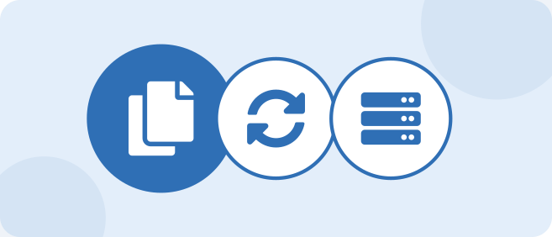
Why Use Multi-AZ?
High availability
Database keeps running after a failure
Fault tolerance
No single data centre is a single point of failure
Protection against AZ failure
Standby sits in a different AZ
Automatic failover
No manual action required
Typically completes in about 60-120 seconds
Real-world scenario
A power issue takes down AZ-a. RDS fails over to AZ-b; the application reconnects to the same endpoint within two minutes.
Important for exam / interview
Failover can also occur for instance failure, storage failure, OS patching, instance-class changes or a manual reboot with failover.
Multi-AZ is for availability, not for performance.
26
Notes:
TROUBLESHOOTING
Application errors for a minute after failover | Connections to the old primary were dropped | Use the DNS endpoint, enable reconnect logic and connection-pool retry, keep DNS TTL low in the client

Slide 27

Read Replicas
What is a read replica?
Copy of the database used mainly for read operations
Helps reduce load on the primary database
Useful for read-heavy applications
Real-world scenario
End-of-month reports were slowing down the live admission system. Pointing the report tool at a read replica removed the slowdown.
Important for exam / interview
Replication is asynchronous, so replicas can lag behind (ReplicaLag metric).
A replica can be promoted to a standalone database, useful for disaster recovery or migrations.
Replicas have their own endpoints; the application must send reads to them itself.
RDS MySQL, MariaDB and PostgreSQL support up to 15 read replicas; replicas can be cross-Region.
27
Notes:
CONSOLE STEPS
RDS console, select the source DB, Actions, then Create read replica.
Choose the DB instance class, Region (same or different) and replica identifier.
Optionally enable Multi-AZ on the replica; set Public access as required.
Click Create read replica; copy the replica endpoint and use it for reporting queries.
TROUBLESHOOTING
Replica returns old data | Replication lag | Monitor ReplicaLag; use a larger replica class; avoid long write transactions on the primary
"Read-only" error on write | Application is writing to a replica | Send writes to the primary endpoint

Slide 28
Read Replicas: Diagram
Writes go to the primary; reporting and heavy reads go to replicas.
Read Replica 1
reads
Application
Primary RDS
Replication from the primary to the replicas is asynchronous.
writes and reads
Read Replica 2
reads
28

Slide 29
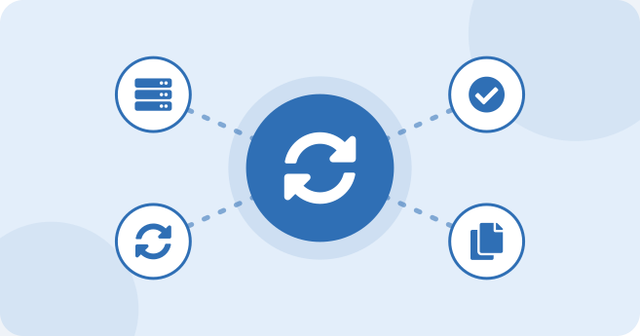
Multi-AZ vs Read Replica
Multi-AZ - high availability, standby database, automatic failover, failure protection
Read Replica - read scalability, readable copy, reduces read load
Important for exam / interview
Memory aid: Multi-AZ = Make it survive. Read replica = Read more.
Exam keywords: "high availability", "failover" -> Multi-AZ. "Read-heavy", "reporting", "scale reads" -> read replica.
They can be combined: a Multi-AZ primary with one or more read replicas.
29

Slide 30
Side-by-side comparison
Aspect | Multi-AZ | Read Replica
Main purpose | High availability / disaster protection | Read scalability
Replication | Synchronous | Asynchronous
Readable? | No (standby is not readable in instance deployments) | Yes
Failover | Automatic | Manual promotion
Endpoint | One endpoint shared | Separate endpoint per replica
Placement | Another AZ in the same Region | Same AZ, another AZ or another Region
Reduces read load? | No | Yes
30

Slide 31
Multi-AZ and Read Replicas:
How they combine
Primary with a synchronous standby in another AZ: survives an AZ failure; the endpoint stays the same.
Read replicas (asynchronous): serve product browsing and reports, scaling reads.
Writes go to the primary; reads go to replica endpoints.
Failover protects the primary; replicas do not replace the standby.
Trade-offs
Cost: the standby and every replica are extra instances and storage.
Replica lag: asynchronous copies can return slightly stale data, so avoid them for checkout or payment reads.
The standby cannot serve reads (standard instance deployment), so it adds no read capacity.
More components to monitor (ReplicaLag, failover events).
Key point: Multi-AZ = survive an AZ loss; read replicas = scale reads. Combine both, accepting higher cost and replica lag.
31
Notes:
Q18. Multi-AZ gives availability (synchronous standby, same endpoint, failover about 60-120 s, standby not readable in standard instance deployments). Read replicas give read scale (asynchronous, own endpoint, lag possible). Together they suit a read-heavy e-commerce site; trade-off is cost and stale reads.

Slide 32
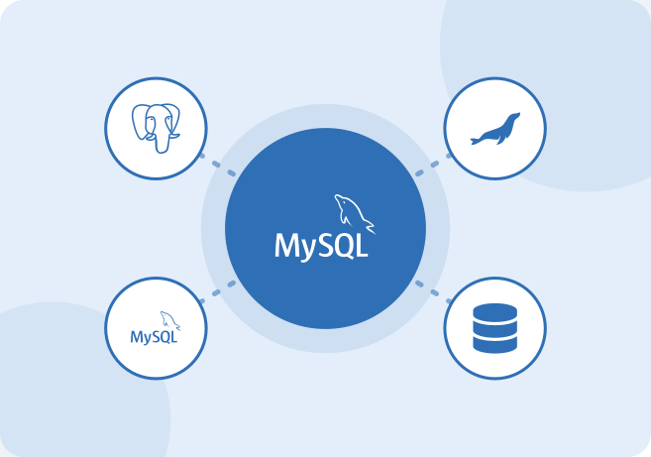
RDS Example
College management application
Student information stored in RDS
Multi-AZ for availability
Read replica for reports
Real-world scenario
Admissions open in July. The web app stays on the primary for writes, while the examination cell runs heavy reports on the read replica without slowing admissions.
32
Notes:
HANDS-ON LAB
Lab 2 - Enable Multi-AZ on the lab database, perform Reboot with failover and record how long the application takes to reconnect. Create a read replica and run a SELECT against its endpoint.

Slide 33
RDS Example: Diagram
Complete college architecture using RDS.
Students / Staff
Web app
EC2 or containers
reports
writes + reads
Primary RDS MySQL
Read Replica
AZ-a
reports
sync replication
Standby RDS
AZ-b
33

Slide 34
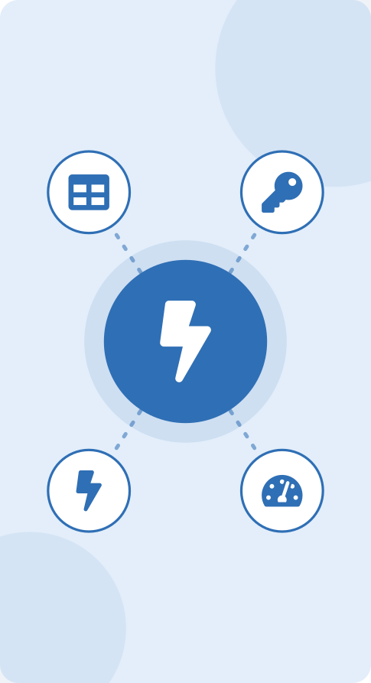
Part C
Amazon DynamoDB
In this part
What Is DynamoDB?
RDS vs DynamoDB
DynamoDB Basic Concepts
DynamoDB Primary Key
DynamoDB Indexes
DynamoDB Accelerator (DAX)
DynamoDB Use Cases
34

Slide 35
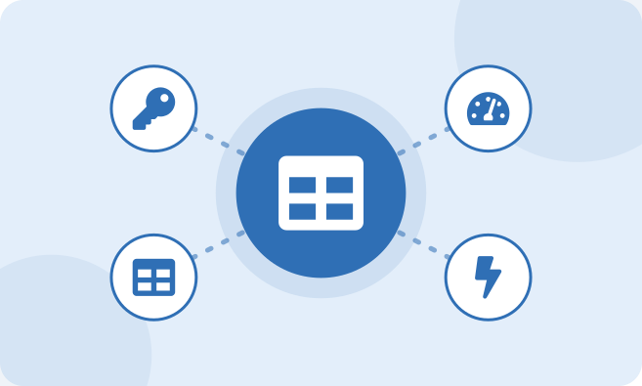
What Is DynamoDB?
Fully managed NoSQL database
Serverless: no servers, patching or capacity planning to manage
Key-value and document database
Items can be simple key-value pairs or JSON-like documents
Highly scalable
Scales to very high request volumes with consistent performance
Designed for applications requiring fast access
Single-digit millisecond latency
Important for exam / interview
DynamoDB is accessed over HTTPS through the AWS API; it does not sit inside your VPC like RDS (use VPC endpoints for private access).
Maximum item size is 400 KB.
35

Slide 36
Features to remember
Feature | Meaning
Capacity modes | On-demand (pay per request) or provisioned (set read/write capacity units)
Availability | Data replicated across multiple AZs in a Region automatically
Global Tables | Multi-Region, multi-active replication
Streams / TTL / PITR | Change events, auto-expiry of items, point-in-time recovery
Encryption | Always encrypted at rest
36

Slide 37
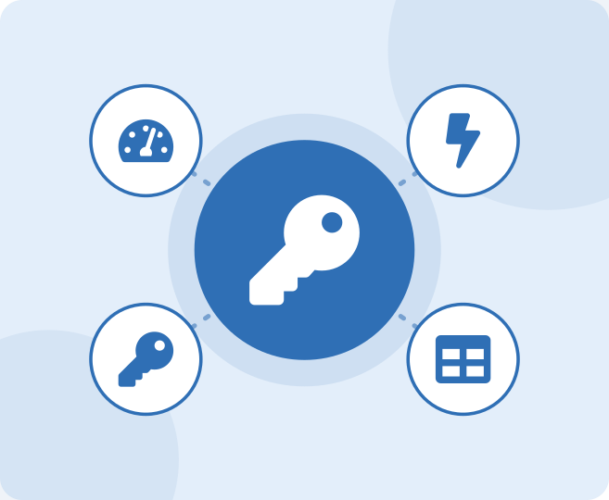
RDS vs DynamoDB
RDS - relational, tables, SQL
DynamoDB - NoSQL, key-value, documents
Simple examples
Real-world scenario
Ad-hoc reports with many joins - use RDS. Millions of "add to cart" updates per hour - use DynamoDB.
37

Slide 38
RDS vs DynamoDB: Diagram
Same question, two answers.
Amazon RDS (SQL)
SELECT * FROM Students WHERE StudentID = 101;
Amazon DynamoDB (API call)
GetItem(TableName="Students", Key={"StudentID":{"N":"101"}})
38

Slide 39
RDS vs DynamoDB
Aspect | RDS | DynamoDB
Data model | Tables, rows, relationships | Items with attributes, key-value/document
Schema | Fixed | Flexible beyond the primary key
Queries | SQL, JOINs, complex queries | Key-based access, Query/Scan, PartiQL; no joins
Scaling | Instance size and read replicas | Automatic horizontal scaling
Management | Instances, storage, Multi-AZ | Serverless
Connectivity | VPC endpoint, security groups | HTTPS API, IAM
Pricing | Instance hours + storage | Per request/capacity + storage
Choose when | Complex queries, transactions, reporting | Massive scale, simple access patterns, low latency
39

Slide 40
RDS vs DynamoDB: Data Model and Usage
Amazon RDS (relational)
Data model: Tables with a fixed schema; rows linked by keys; queried with SQL, joins and ACID transactions.
Amazon DynamoDB (NoSQL)
Data model: Items with flexible attributes in a key-value / document model; found by primary key; no joins.
Usage scenarios in cloud applications
Usage scenarios in cloud applications
Banking, billing and order processing that need transactions
ERP, CRM, HR and student-record systems
Reports and analytics with joins across tables
Moving existing MySQL, PostgreSQL, Oracle or SQL Server apps to the cloud
Shopping carts and user sessions
Gaming player profiles and leaderboards
IoT and clickstream data with high write rates
Mobile and serverless back ends with unpredictable traffic
In practice: many cloud applications use both: orders and payments in RDS, carts and sessions in DynamoDB.
40
Notes:
DATA MODEL: Amazon RDS uses the relational model: data is stored in tables with a fixed schema, rows are linked by keys and queried with SQL, including joins and ACID transactions. Amazon DynamoDB is a NoSQL key-value and document database: data is stored as items with flexible attributes and is found by a primary key (a partition key and optional sort key); there are no joins. USAGE SCENARIOS: RDS suits banking, billing and order processing that need transactions, ERP, CRM, HR and student-record systems, reports with joins, and migration of existing MySQL, PostgreSQL, Oracle or SQL Server applications. DynamoDB suits shopping carts and sessions, gaming profiles and leaderboards, IoT and clickstream data, and mobile or serverless back ends with unpredictable traffic. Scaling differs too: RDS scales by instance size and read replicas, DynamoDB scales out automatically. Many applications use both services together.

Slide 41
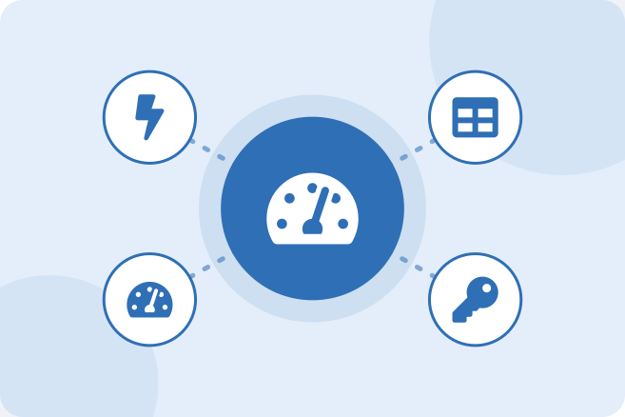
DynamoDB Basic Concepts
Table
Collection of items
Item
One record, like a row
Attribute
One data element of an item, like a column
Primary key
Uniquely identifies each item
Important for exam / interview
Only the primary key attributes are mandatory; other attributes can vary per item.
Item = row, attribute = column - but without a fixed schema.
41
Notes:
CONSOLE STEPS
DynamoDB console, choose Create table.
Table name: Students. Partition key: StudentID, type Number.
Keep default settings (on-demand capacity is simplest for labs) and click Create table.
Open the table, choose Explore table items, then Create item.
Add attributes Name, Course and Age, and save. Use Scan or Query to retrieve the item.
HANDS-ON LAB
Lab 3 - Create the Students table, add 5 items (one with an extra attribute), then run Query by StudentID and Scan with a filter on Course.

Slide 42
DynamoDB Basic Concepts: Diagram
Example Students table (note item 103 has an extra attribute).
Students table
StudentID | Name | Course | Age | Hostel
101 | Rahul | B.Tech | 20
102 | Priya | B.Tech | 21
103 | Aman | MCA | 22 | B-12
Key Point: item 103 has an extra attribute (Hostel). DynamoDB allows a flexible schema per item.
42

Slide 43
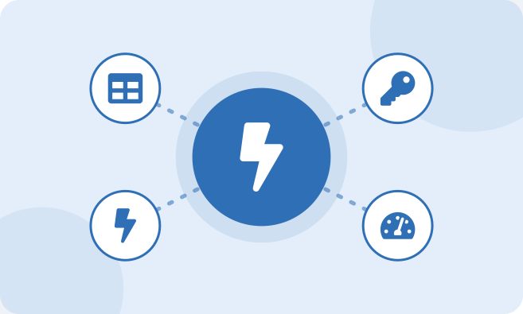
DynamoDB Primary Key
Partition key
Single attribute; DynamoDB hashes it to choose the physical partition
Composite key
Partition key + sort key; the pair must be unique
Sort key allows range queries (begins_with, between)
Why keys are important
They decide how data is stored and how fast it can be read
How DynamoDB identifies data
Hash of partition key locates the partition, sort key orders items inside it
Important for exam / interview
Choose a high-cardinality partition key (StudentID, OrderID), not Course or Country, to avoid hot partitions.
GetItem needs the full primary key; Query needs the partition key.
43
Notes:
TROUBLESHOOTING
ProvisionedThroughputExceeded / throttling | Hot partition or capacity too low | Use a higher-cardinality key, switch to on-demand, increase capacity, retry with exponential backoff

Slide 44
DynamoDB Primary Key: Diagram
Choosing keys for a Marks table.
Marks table: PK = StudentID, SK = Semester
StudentID (PK) | Semester (SK) | Subject | Score
101 | Sem1 | Cloud | 88
101 | Sem2 | DevOps | 91
Query both items for one student
Query: StudentID = 101 AND Semester begins_with "Sem"
Key Point: the partition key finds the student; the sort key orders and filters the student's items.
44

Slide 45
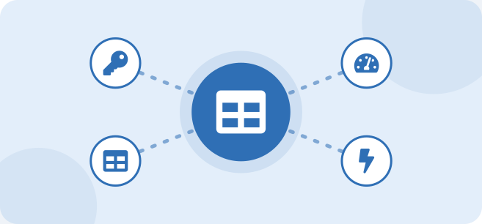
DynamoDB Indexes
Why indexes are required
Primary key is the only fast access path by default
Searching data efficiently
Query on other attributes without scanning the whole table
Local Secondary Index
Same partition key, different sort key
Must be created with the table
Global Secondary Index
Different partition and sort key
Can be added or removed at any time
Basic difference
LSI = alternative sort order in a partition; GSI = completely different view
Real-world scenario
Students table is keyed on StudentID but the library needs "all students in course MCA". Add a GSI with partition key Course.
Important for exam / interview
Scan reads every item and is expensive; use indexes and Query instead.
GSIs are eventually consistent only.
45
Notes:
CONSOLE STEPS
Open the table, go to the Indexes tab, choose Create index.
Partition key: Course (String). Name: Course-index. Projected attributes: All.
Create and wait until the index is Active; then Query using the new index.

Slide 46
LSI vs GSI
Aspect | Local Secondary Index | Global Secondary Index
Partition key | Same as base table | Can differ
Sort key | Different | Can differ
When created | Only at table creation | Any time
Throughput | Shares table capacity | Own capacity
Read consistency | Strong or eventual | Eventual only
Default limits | 5 per table | 20 per table
46

Slide 47
LSI vs GSI: when to use each
Aspect | Local Secondary Index (LSI) | Global Secondary Index (GSI)
Partition key | Same as the base table | Can differ from the base table
Sort key | Different from the base table | Own partition key and optional sort key
When defined | At table creation only | Can be added or removed later
Scope | Queries stay within one partition | Queries across the whole table
Use when | You always know the partition key but need another sort order | You must query by a different attribute as the key
Example | StudentID (PK) + ExamDate (LSI sort): one student's exams by date | Course as GSI partition key: list all students in a course
Exam cue: same partition key, different sort → LSI; query by a non-key attribute → GSI (flexible, but extra storage and write cost).
47
Notes:
Q14. LSI = same partition key, alternate sort key, defined at table creation only. GSI = different key for a new access pattern, can be added or removed later; adds storage and write cost. Exam cue: same partition key, different sort -> LSI; query by a non-key attribute as if it were the key -> GSI. Existing slide 45 gives limits and consistency.

Slide 48

DynamoDB Accelerator (DAX)
In-memory caching service for DynamoDB
Reduces response time
Useful for applications with frequent reads
Real-world scenario
A product catalogue page is read 10,000 times a minute but changes once a day. DAX serves most reads from memory and cuts the DynamoDB read cost.
Important for exam / interview
Response time goes from milliseconds to microseconds.
DAX is write-through and compatible with the DynamoDB API; code change is only the client library and endpoint.
Strongly consistent reads bypass the DAX cache.
Not useful for write-heavy workloads.
48
Notes:
TROUBLESHOOTING
No performance gain after adding DAX | App still calls DynamoDB directly, or uses strongly consistent reads | Point the SDK at the DAX endpoint and use eventually consistent reads
Cannot connect to DAX | DAX runs inside the VPC | Run the app in the same VPC and allow the DAX port (8111) in the security group

Slide 49
DynamoDB Accelerator (DAX): Diagram
DAX sits between the application and DynamoDB.
Application
DAX client (same API as DynamoDB)
DAX cluster
Cache hit: microsecond response
Cache miss: read from DynamoDB
DynamoDB
Key Point: DAX sits between the application and DynamoDB, so the application code barely changes.
49

Slide 50
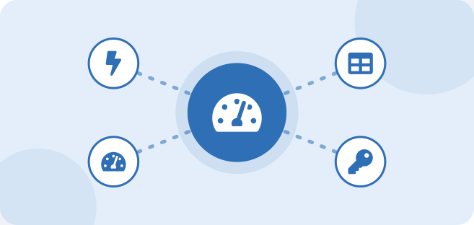
DynamoDB Use Cases
Gaming applications
Player profiles, leaderboards, session state
Shopping carts
Fast reads/writes per user, huge spikes on sale days
Mobile applications
User data and preferences at scale
IoT applications
Millions of sensor readings written per second
Real-time applications
Low and predictable latency
Real-world scenario
A ticket-booking site sees 100x traffic when sales open. On-demand DynamoDB absorbs the spike without any capacity planning.
Important for exam / interview
Exam clue words: "millisecond latency at any scale", "serverless NoSQL", "session store", "IoT data" -> DynamoDB.
Poor fit: complex joins and ad-hoc analytics.
50

Slide 51
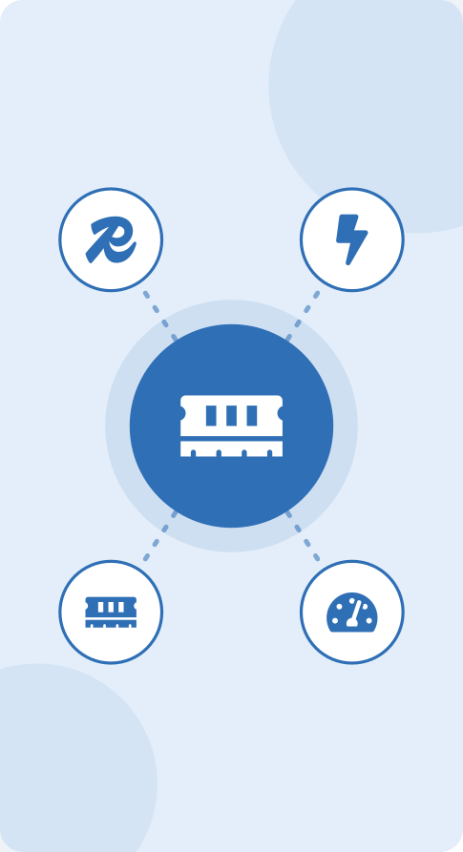
Part D
Amazon ElastiCache
In this part
What Is Caching?
Amazon ElastiCache
Redis and Memcached
Example: Online Shopping
DAX vs ElastiCache
51

Slide 52
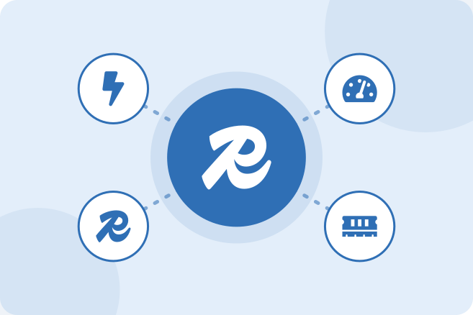
What Is Caching?
Temporary storage of frequently used data
Reduces database requests
Improves application response time
Important for exam / interview
Cache hit = found in cache. Cache miss = not found, go to the database.
Caches hold copies; the database remains the source of truth.
52

Slide 53
What Is Caching?: Diagram
Without and with a cache.
Without cache
User
Application
Database
With cache
User
Application
Cache
hit: return fast
miss
Database, then store result in cache
53

Slide 54
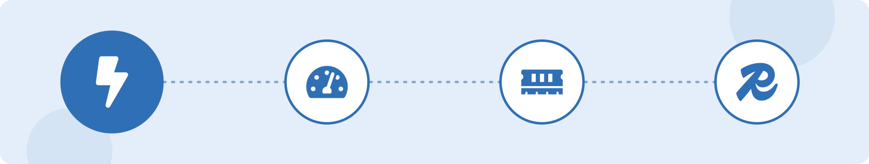
Common caching strategies
Strategy | How it works
Lazy loading (cache-aside) | App checks cache first; on a miss it reads the database and fills the cache
Write-through | Every write goes to the cache and the database
TTL (time to live) | Cached data expires after a set time so stale data is limited
54

Slide 55
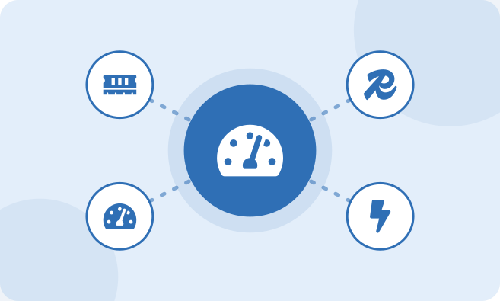
Amazon ElastiCache
Managed caching service
Stores frequently accessed data in memory
Reduces database workload
Improves application performance
Important for exam / interview
ElastiCache is accessed through a private endpoint inside the VPC, not the public internet.
Data is in memory: very fast, but memory is limited and (for Memcached) volatile.
55
Notes:
CONSOLE STEPS
ElastiCache console, choose Create cache.
Select the engine (Valkey / Redis OSS or Memcached) and Serverless or Design your own cache.
Choose a node type, number of replicas and subnet group in your VPC.
Select a security group that allows the cache port (6379 for Redis/Valkey, 11211 for Memcached) from the application.
Create and copy the cache endpoint into the application configuration.
TROUBLESHOOTING
Application cannot reach the cache | Different VPC or security group blocks the port | Place the cache and application in the same VPC and allow the port from the application security group
Users see old data | No TTL or no invalidation | Set a TTL and delete/update cached keys when data changes

Slide 56
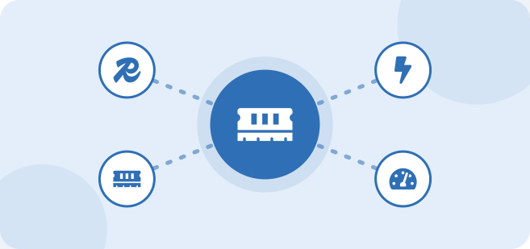
Redis and Memcached
Two common caching technologies
Redis
Memcached
Basic differences and use cases
Important for exam / interview
Rule of thumb: need persistence, replication or rich data types -> Redis/Valkey; need the simplest multi-threaded cache -> Memcached.
ElastiCache also supports Valkey, an open-source Redis-compatible engine.
56

Slide 57
Redis (and Valkey) vs Memcached
Aspect | Redis / Valkey | Memcached
Data types | Strings, hashes, lists, sets, sorted sets | Simple key-value strings
Persistence and backup | Supported | Not supported
Replication and Multi-AZ failover | Supported | Not supported
Publish/Subscribe | Supported | No
Threading | Mainly single-threaded core | Multi-threaded
Typical use | Sessions, leaderboards, queues, rich caching | Simple, large, disposable cache
57

Slide 58
Example: Online Shopping: Diagram
Cache-aside flow for a product page.
Cache-aside flow for a product page
product = cache.get("product:123")
if product is None: # cache miss
product = db.query("SELECT * FROM products WHERE id=123")
cache.set("product:123", product, ttl=300)
return product # next request is a cache hit
Key Point: the first request fills the cache; later requests are cache hits until the TTL (300 s) expires.
58

Slide 59
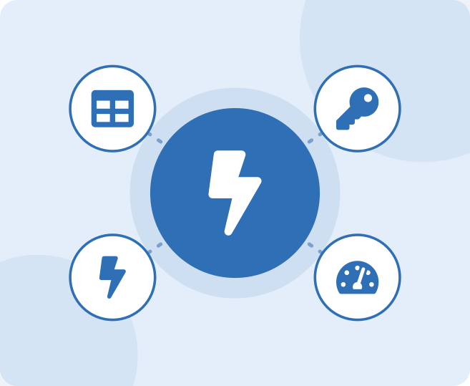
DAX vs ElastiCache
DAX - designed for DynamoDB only
ElastiCache - general-purpose caching
Important for exam / interview
If the question says "DynamoDB" and "cache", answer DAX. Otherwise answer ElastiCache.
59

Slide 60
DAX vs ElastiCache
Aspect | DAX | ElastiCache
Purpose | Cache for DynamoDB | General-purpose cache
Integration | Drop-in, uses DynamoDB API | Application code manages the cache
Engines | DAX only | Redis/Valkey or Memcached
Caches | DynamoDB item and query results | Database results, sessions, computed data
Latency | Microseconds for DynamoDB reads | Sub-millisecond for any cached data
60

Slide 61
How ElastiCache Improve Performance
Faster responses
Data is served from memory in microseconds to sub-milliseconds, not from slower disk-based queries.
1
What gets cached
Product pages and catalogue data
Session and login data
Results of frequent queries
Leaderboards and counters
API responses
Engines
Redis / Valkey: rich data types, replication, persistence
Memcached: simple, fast, disposable cache
Lower database load
Repeated reads are answered by the cache, so the database handles fewer queries.
2
Higher throughput
A cache serves very large numbers of reads per second and absorbs traffic spikes.
3
Lower cost
A smaller database and fewer read replicas can carry the same workload.
4
Role: ElastiCache sits between the application and the database so frequently used data is read from fast memory.
61
Notes:
Amazon ElastiCache is a managed in-memory caching service (Redis/Valkey or Memcached). It sits between the application and the database and stores frequently used data in memory. Its role in improving performance: responses come from memory in microseconds to sub-milliseconds instead of slower disk-based database queries; repeated reads are answered by the cache so the database handles fewer queries; the cache can serve very large numbers of reads per second and absorb traffic spikes; and a smaller database and fewer replicas can handle the same workload, which lowers cost. Typical cached data are product pages, session data, query results, leaderboards and API responses.

Slide 62
Caching: Speed, Availability and Resource Use
Speed
Memory is far faster than disk-based queries
A cache hit skips the database round trip
DAX gives microsecond reads for DynamoDB
Availability
Cache absorbs read spikes so the database is not overwhelmed
Redis / Valkey replicas with Multi-AZ failover
Hot data keeps being served if the database is slow
Resource utilization
Fewer queries: lower database CPU and I/O
Smaller instances and fewer read replicas
Memory holds only the hot data
Cache-aside flow
User
Application
check
Cache
miss
Database
hit: return data at once
then store result in cache
Result: faster responses, more resilient reads and a smaller, cheaper database.
62
Notes:
Caching services such as Amazon ElastiCache (general purpose) and DynamoDB Accelerator, DAX (for DynamoDB) improve three things. SPEED: memory is far faster than disk-based queries, a cache hit skips the database round trip, and DAX gives microsecond reads for DynamoDB. AVAILABILITY: the cache absorbs read spikes so the database is not overwhelmed, Redis/Valkey replicas with Multi-AZ failover keep the cache itself available, and hot data can continue to be served while the database is slow or busy. RESOURCE UTILIZATION: fewer queries mean lower database CPU and I/O, smaller instances and fewer read replicas are needed, and memory is used only for hot data. The flow shown is cache-aside: the application checks the cache first; on a hit it returns the data immediately, on a miss it reads the database and stores the result in the cache for next time.

Slide 63
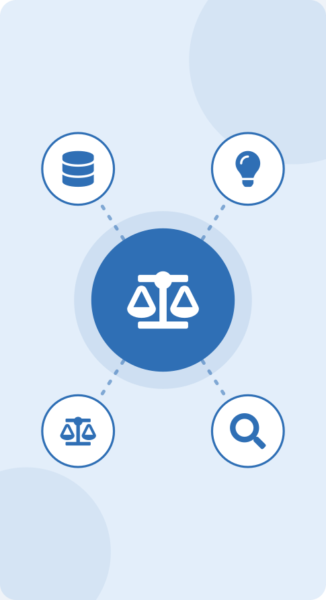
Part E
Database Design & Selection
In this part
Choosing a Database
Which Database Should We Choose?
Example: College Application
Database Workload Optimization
64

Slide 64
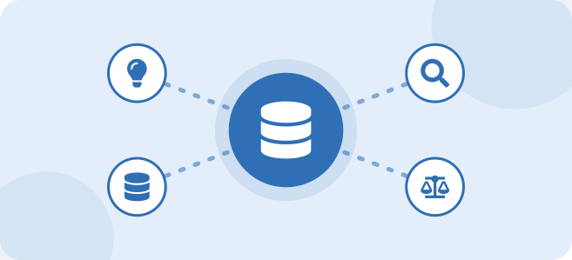
Choosing a Database
Type of data
Structured with relations or flexible/unstructured
Number of users
Hundreds or millions
Read/write requirements
Read-heavy, write-heavy or balanced
Scalability
Vertical limits vs horizontal scale-out
Performance
Latency targets
Availability
Acceptable downtime
Cost
Instance hours vs per-request pricing
Real-world scenario
A hostel allocation system with 800 users needs joins and constraints - RDS. A mobile game with 5 million players needs fast key lookups - DynamoDB.
Important for exam / interview
Start from the access pattern: how will data be read and written?
65

Slide 65
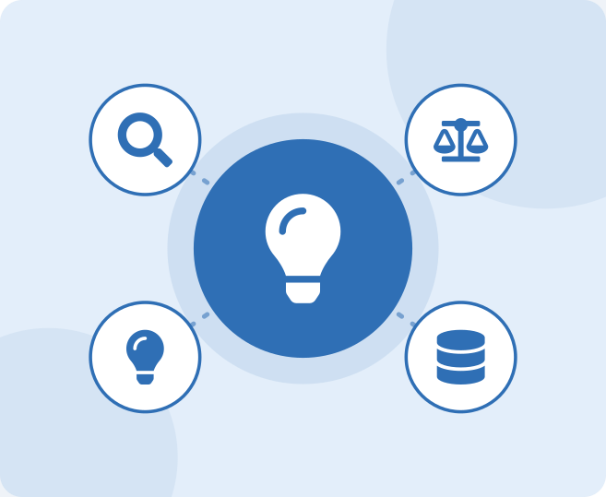
Which Database Should We Choose?
Need relational database? -> RDS
Need NoSQL? -> DynamoDB
Need fast temporary data? -> ElastiCache
Important for exam / interview
Real systems combine services; the exam often asks for the best fit for one requirement.
66

Slide 66
Which Database Should We Choose?: Diagram
Selection flow.
Need joins, SQL, transactions?
Amazon RDS
Aurora if cloud-native scale is needed
Need huge scale, key-based access?
Amazon DynamoDB
Need microsecond reads of hot data?
ElastiCache
or DAX for DynamoDB
Need analytics on huge historical data?
Amazon Redshift
67

Slide 67

Scenario to service
Scenario | Service
Banking with strict transactions | RDS / Aurora
Shopping cart, millions of users | DynamoDB
Session store, leaderboard | ElastiCache (Redis/Valkey)
Speed up DynamoDB reads | DAX
Reporting without hitting the primary | RDS read replica
68

Slide 68
Evaluate: Database Selection for Three Workloads
Workload | Best fit | Why
Banking transaction system | Amazon RDS | Fixed schema, joins, strong ACID transactions and relational integrity for balances and ledgers
IoT data stream | Amazon DynamoDB | Massive write scale, flexible item shape, key-based access, serverless capacity
Web session store | Amazon ElastiCache (Redis/Valkey) | In-memory speed, TTL for expiry, low latency; durable session backup optional in DynamoDB
Selection rules
SQL, relationships, strong consistency → RDS. Huge scale, simple key access → DynamoDB.
Sub-millisecond hot data or sessions → ElastiCache (a cache layer, not the only database of record for money).
Key point: match the access pattern to the service: relational integrity (RDS), scale by key (DynamoDB), speed for hot data (ElastiCache).
69
Notes:
Q20. Banking = RDS (ACID, joins). IoT stream = DynamoDB (massive write scale, key access, serverless). Web sessions = ElastiCache (in-memory, TTL); optional durable backup in DynamoDB.

Slide 69
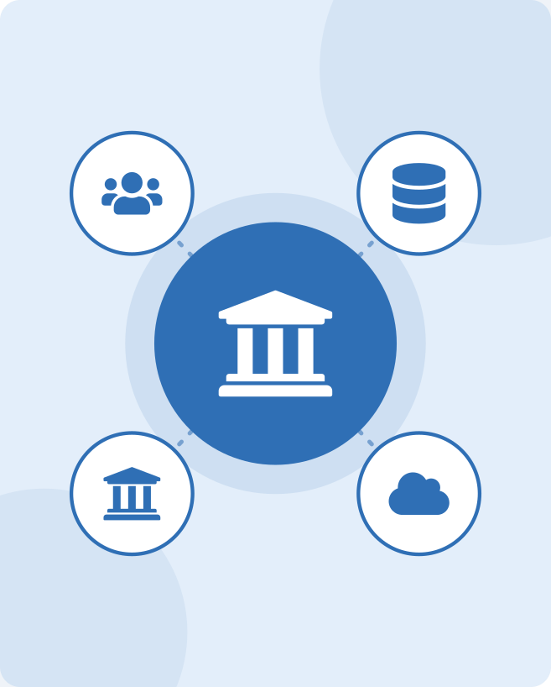
Example: College Application
Student information -> RDS
Frequently accessed results -> Cache
Large-scale application requiring NoSQL -> DynamoDB
Reports -> Read Replica
70

Slide 70
Example: College Application: Diagram
One application, four data needs.
Web / Mobile app
RDS
ElastiCache
DynamoDB
Read Replica
records
results
activity
reports
Key Point: one application, four data needs: each handled by the service built for it.
71

Slide 71

Example: College Application
Data | Service | Reason
Student records, fees | RDS | Relational, transactions
Published results | ElastiCache | Read very often, change rarely
Login activity, notifications at huge scale | DynamoDB | Simple key access, scale
Monthly reports | Read replica | Keeps reports off the primary
72

Slide 72
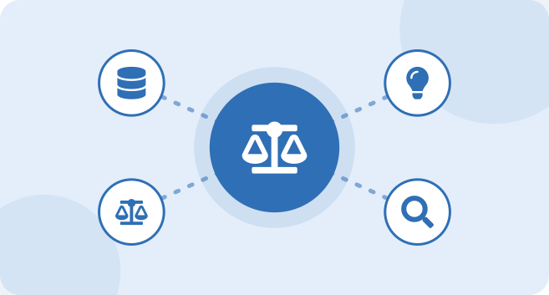
Database Workload Optimization
Use indexes
Index columns used in WHERE and JOIN
Use caching
Serve repeated reads from memory
Use read replicas
Move reporting and read traffic away from the primary
Choose appropriate database
Use the service that fits the access pattern
Avoid unnecessary queries
No SELECT *; avoid repeated or N+1 queries
Monitor performance
CloudWatch metrics and Performance Insights
Important for exam / interview
Order of optimisation: fix queries and indexes first, then cache, then replicas, then bigger hardware.
RDS Proxy pools connections and also speeds up failover for apps such as Lambda.
73
Notes:
TROUBLESHOOTING
High CPU on RDS | Missing indexes or expensive queries | Use Performance Insights to find top SQL, add indexes, scale instance class
Too many connections | Connection per request | Use connection pooling or RDS Proxy
Slow reads on DynamoDB | Scans, hot keys | Use Query with proper keys, add a GSI, consider DAX

Slide 73
Workload Optimization Strategies
Strategy | How it is done | Main benefit
Indexing and query tuning | Index columns in WHERE/JOIN; avoid full scans; review slow queries in Performance Insights | Faster queries, lower CPU
Caching | ElastiCache or DAX for repeated reads | Low latency, less database load
Read replicas | Send reports and read-heavy traffic to replicas | Primary stays fast for writes
Right database for the job | RDS for relational, DynamoDB for key-value scale, ElastiCache for hot data | Fits the access pattern
Connection management | Connection pooling or RDS Proxy | Fewer connection errors, faster failover
Right-sizing and scaling | Instance class, storage autoscaling, DynamoDB on-demand or auto scaling | Capacity matches demand
Multi-AZ, backups, monitoring | Multi-AZ, automated backups, CloudWatch alarms | Resilience and early warning
74
Notes:
Database workload optimization means matching resources and design to the workload so that it runs fast, stays available and costs little to operate. Main strategies: index columns used in WHERE and JOIN clauses and tune slow queries (found with Performance Insights) for faster queries and lower CPU; add caching with ElastiCache or DAX to cut latency and database load; use read replicas to move reports and read-heavy traffic off the primary; choose the right database for the access pattern (RDS, DynamoDB or ElastiCache); manage connections with pooling or RDS Proxy; right-size instances and use storage autoscaling or DynamoDB on-demand or auto scaling so capacity matches demand; and use Multi-AZ, automated backups and CloudWatch monitoring for resilience and early warning.

Slide 74
How Optimization Improves Results
Performance
Indexes and tuned queries cut response time
Caching serves hot data from memory
Read replicas spread the read load
The right database type avoids slow workarounds
Reliability
Multi-AZ failover and automated backups protect against failure
RDS Proxy keeps connections alive during failover
Replicas hold extra copies of data
Caching and replicas stop the primary being overloaded
Operational efficiency
Managed services reduce patching and administration
Autoscaling removes manual capacity work
Monitoring finds problems early
Right-sizing lowers cost
Together: a tuned, cached and replicated database responds faster, survives failures and costs less to run.
75
Notes:
Optimization strategies contribute to three outcomes. PERFORMANCE: indexes and tuned queries cut response time, caching serves hot data from memory, read replicas spread read load, and choosing the right database type avoids slow workarounds. RELIABILITY: Multi-AZ failover and automated backups protect against failure, RDS Proxy keeps connections alive during failover, replicas provide extra copies of data, and caching and replicas stop the primary being overloaded. OPERATIONAL EFFICIENCY: managed services reduce patching and administration, storage autoscaling and auto scaling remove manual capacity work, monitoring finds problems early, and right-sizing lowers cost. Together they give a database that responds faster, survives failures and costs less to run.

Slide 75
Optimization Workflow: Where to Start
1
2
3
4
5
6
Measure
Performance Insights and CloudWatch show slow queries and bottlenecks.
Tune queries
Fix slow SQL, add indexes, avoid full scans.
Add caching
ElastiCache or DAX answers repeated reads.
Offload reads
Read replicas take reports and read-heavy traffic.
Scale and right-size
Instance class, storage autoscaling, on-demand capacity.
Monitor, repeat
Alarms and regular reviews catch new problems.
Why this order
Cheaper, simpler fixes come first. Bigger hardware is the last resort: it costs the most and does not fix inefficient queries.
Example: slow results page
Slow query found, index added, top results cached, reports moved to a read replica.
76
Notes:
Optimization follows an order: simpler and cheaper fixes first, bigger hardware last. 1) Measure with Performance Insights and CloudWatch to find slow queries and bottlenecks. 2) Tune queries and indexes. 3) Add caching for repeated reads. 4) Offload reads with read replicas. 5) Scale and right-size: bigger instance class, storage autoscaling, on-demand capacity. 6) Monitor with alarms and review regularly, then repeat. Example: a slow results page is traced to one slow query, an index is added, the top results are cached and the reports are moved to a read replica.

Slide 76
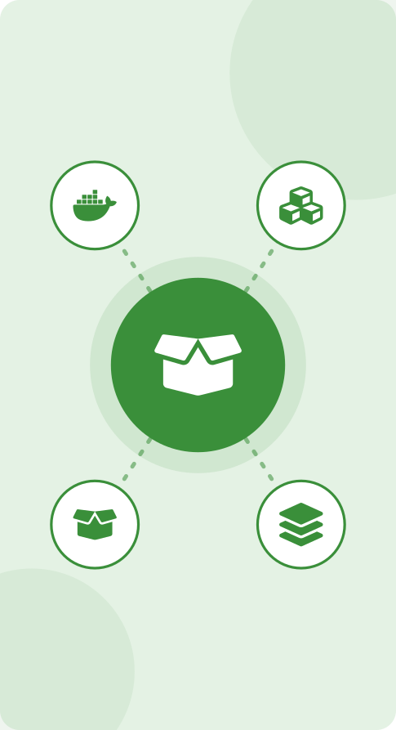
Part F
Containerization
In this part
What Is a Container?
Why Containers?
Virtual Machine vs Container
Container Architecture
Docker Basics
Image vs Container
77

Slide 77
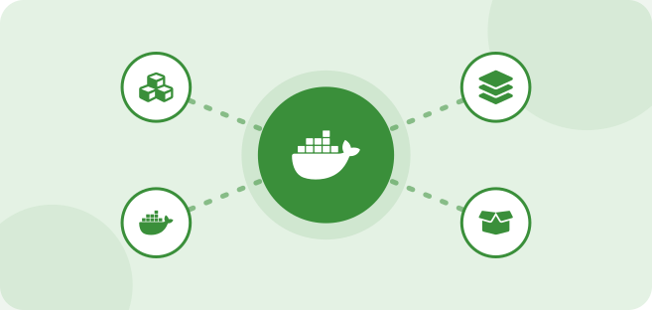
What Is a Container?
Lightweight environment for running applications
Contains application and required dependencies
Portable between environments
Real-world scenario
A student app runs on a laptop but fails on the server because of a different Python version. Packaged as a container, it runs identically everywhere.
Important for exam / interview
"It works on my machine" is the problem containers solve.
A container is a running process isolated by the OS, not a separate computer.
78

Slide 78
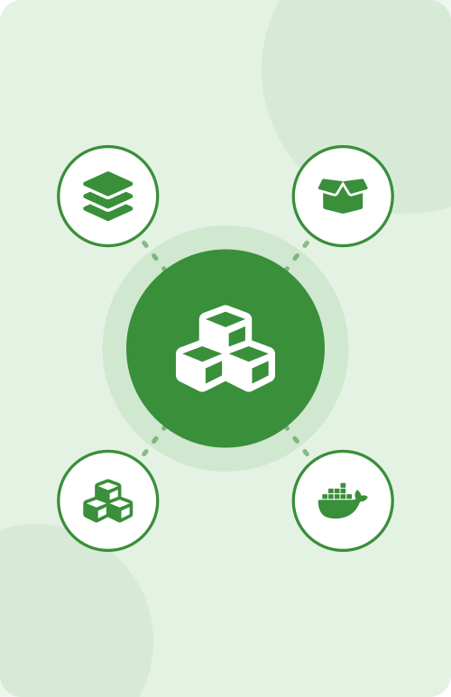
What Is a Container?: Diagram
A container packs code, runtime and libraries together.
Container
Your application code
Runtime (Java / Python / Node)
Libraries and dependencies
Host operating system kernel
the container runs on the shared kernel
79

Slide 79
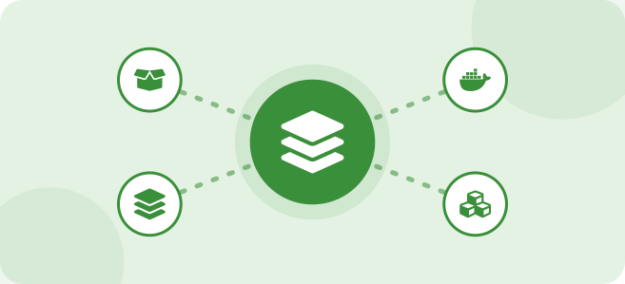
Why Containers?
Consistent environment
Same behaviour in development, test and production
Fast deployment
Start in seconds
Lightweight
No guest OS, smaller than VMs
Easy scaling
Run more copies quickly
Application isolation
Each app has its own libraries and processes
Real-world scenario
A microservices application has 12 small services, each in its own container; only the payment service is scaled up on sale days.
Important for exam / interview
Containers pair naturally with microservices, CI/CD pipelines and DevOps.
80

Slide 80
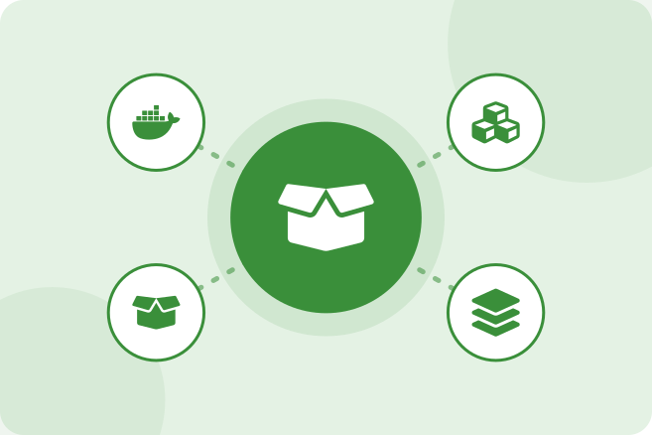
Virtual Machine vs Container
Virtual Machine:
Full OS, heavier, slower startup, more resources
Container:
Shares host kernel, lightweight, fast startup, fewer resources
Important for exam / interview
Containers can run on EC2 instances, so the two are often used together.
VMs give stronger isolation; containers give speed and density.
81

Slide 81
Virtual Machine vs Container: Diagram
Layers compared.
Virtual machines
Containers
App A
App B
App C
App A
App B
App C
Guest OS (each)
Container engine
Hypervisor
Host OS
Host hardware
Host hardware
82

Slide 82
VM vs container
Aspect | Virtual Machine | Container
Operating system | Full guest OS per VM | Shares host OS kernel
Size | GBs | MBs
Startup | Minutes | Seconds
Isolation | Stronger (hardware level) | Process level
Density | Fewer per host | Many per host
AWS example | Amazon EC2 | Amazon ECS / EKS / Fargate
83

Slide 83
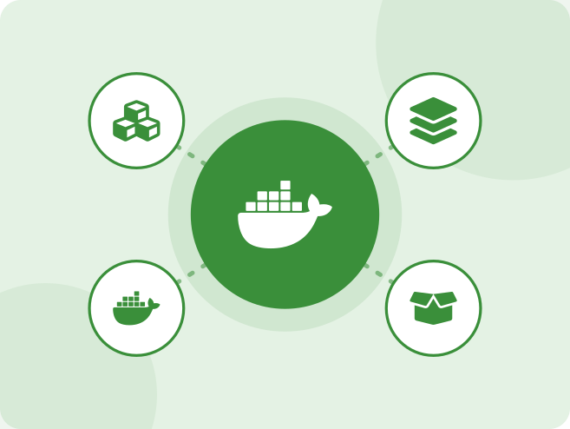
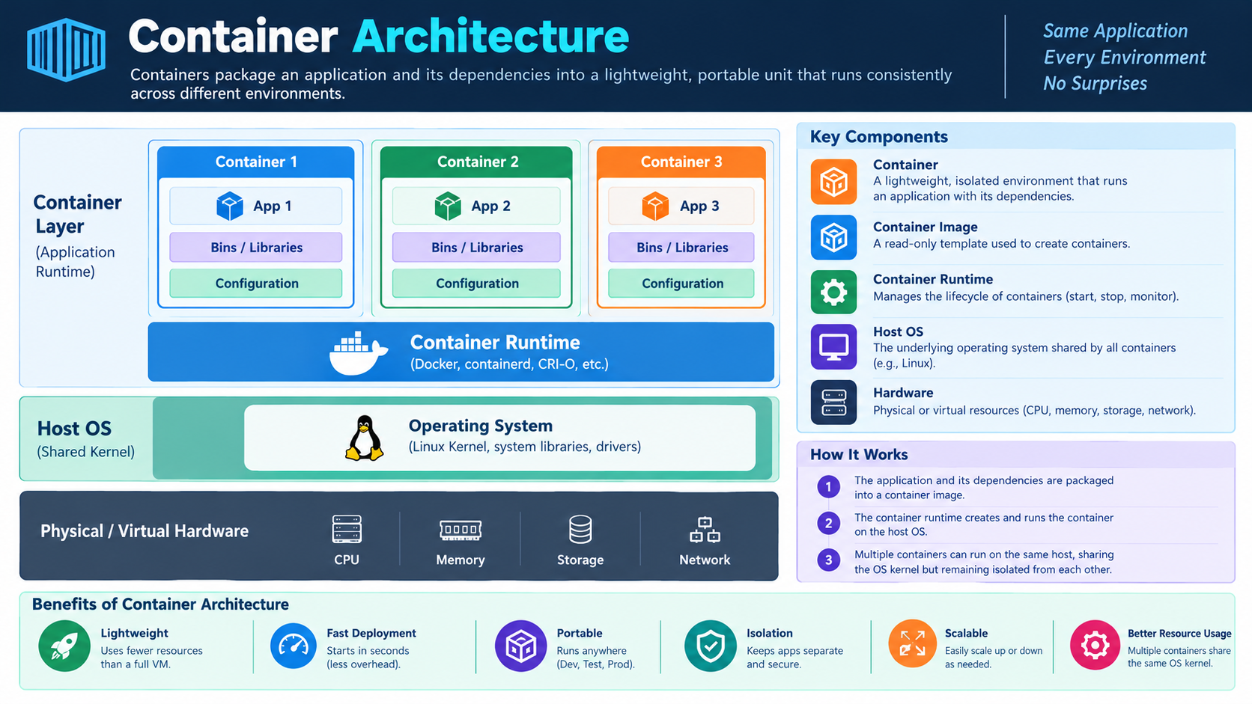
Container Architecture
Containers Package an application and its dependencies into a lightweight, portable unit that runs consistently across different environments.
Important for exam / interview
The container engine (for example Docker or containerd) creates, runs and isolates containers using Linux namespaces and cgroups.
84

Slide 84
Container Architecture: Diagram
Each container runs on the shared OS through the container engine.
Physical server
App 1
App 2
App 3
Operating system
Container engine (Docker)
Key Point: each container runs on the shared OS through the container engine.
85

Slide 85
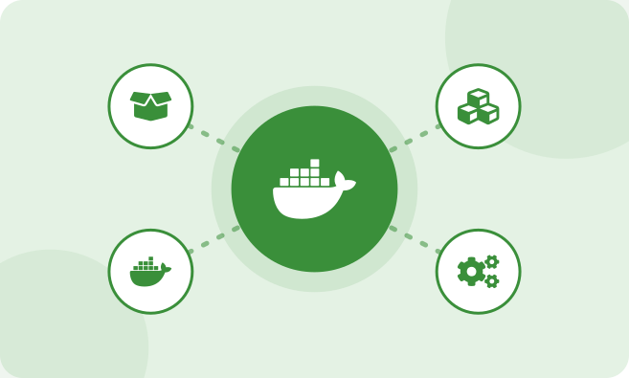
Docker Basics
Docker
Platform to build, ship and run containers
Docker Image
Read-only template with app and dependencies
Docker Container
Running instance of an image
Dockerfile
Text file with build instructions
Container Registry
Storage for images (Docker Hub, Amazon ECR)
Important for exam / interview
Dockerfile -> (docker build) -> Image -> (docker run) -> Container.
Each Dockerfile instruction creates a layer; unchanged layers are cached so rebuilds are fast.
86
Notes:
HANDS-ON LAB
Lab 4 - Write the Dockerfile above, build the image, run it on port 8080 and open the page in a browser.
TROUBLESHOOTING
Container exits immediately | Main process finished or crashed | docker logs <name>; make sure the app runs in the foreground
Port not reachable | Port not published | Use -p hostPort:containerPort
Cannot connect to the Docker daemon | Docker service not running or no permission | Start Docker; add the user to the docker group

Slide 86
Docker Basics: Diagram
A minimal Dockerfile and the commands to use it.
Dockerfile
Commands
FROM nginx:alpine
COPY ./site /usr/share/nginx/html
EXPOSE 80
docker build -t college-web:1.0 .
docker run -d -p 8080:80 --name web college-web:1.0
docker ps
docker logs web
docker stop web
Key Point: build once from the Dockerfile, then run the same image anywhere.
87

Slide 87
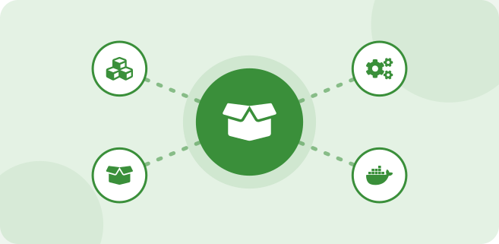
Image vs Container
Image = blueprint/template
Container = running instance of an image
Important for exam / interview
Analogy: image = recipe or class; container = dish or object.
Images are immutable; changes inside a running container are lost when it is removed. Store data outside (database, EFS, S3).
Tag images with versions (1.0, 1.1) instead of relying only on latest.
88

Slide 88
Image vs Container: Diagram
One image can create many containers.
docker run
Container 1
running application
Docker image
One image can create many containers.
Container 2
read-only template
running application
Container 3
running application
89

Slide 89
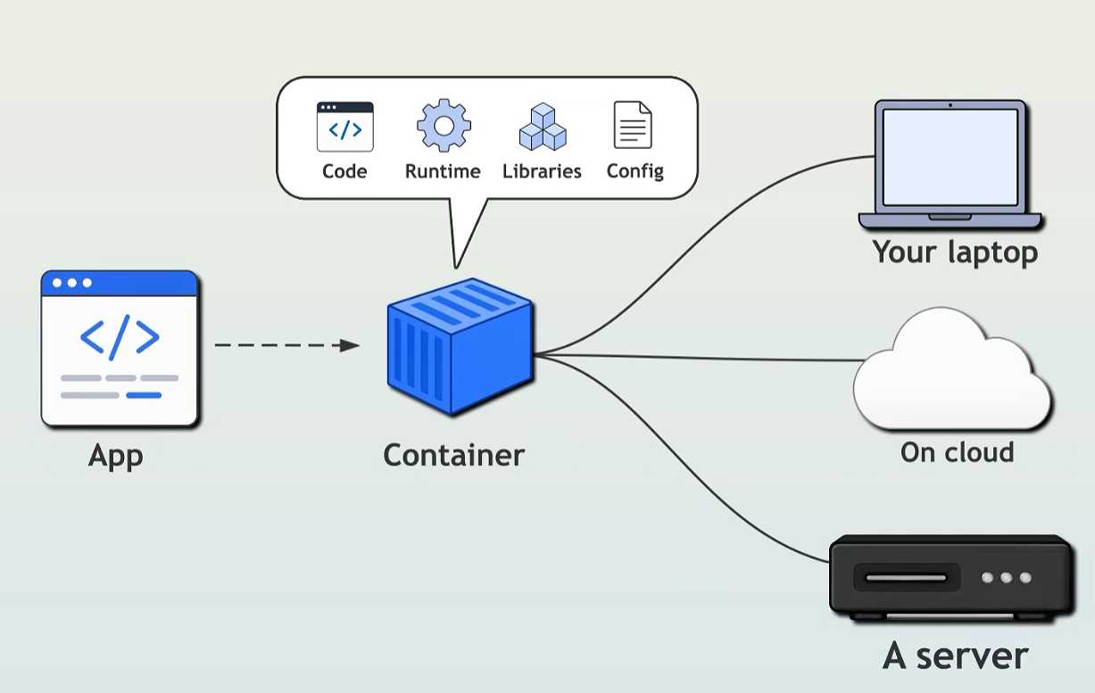

Slide 90
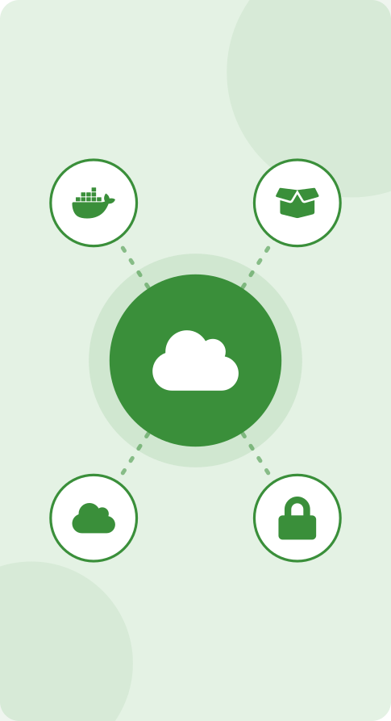
Part G
Amazon ECR
In this part
What Is Amazon ECR?
Container Deployment Using ECR
ECR Features
91

Slide 91
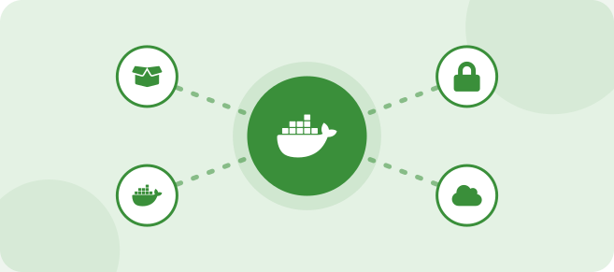
What Is Amazon ECR?
Elastic Container Registry
Stores container images
Works with ECS and EKS
Secure image repository
Real-world scenario
Instead of copying Docker images between laptops, the team pushes every build to ECR and all servers pull the same image.
Important for exam / interview
ECR is to container images what S3 is to files: central, durable storage.
Private registry by default; ECR Public exists for publicly shared images.
92

Slide 92
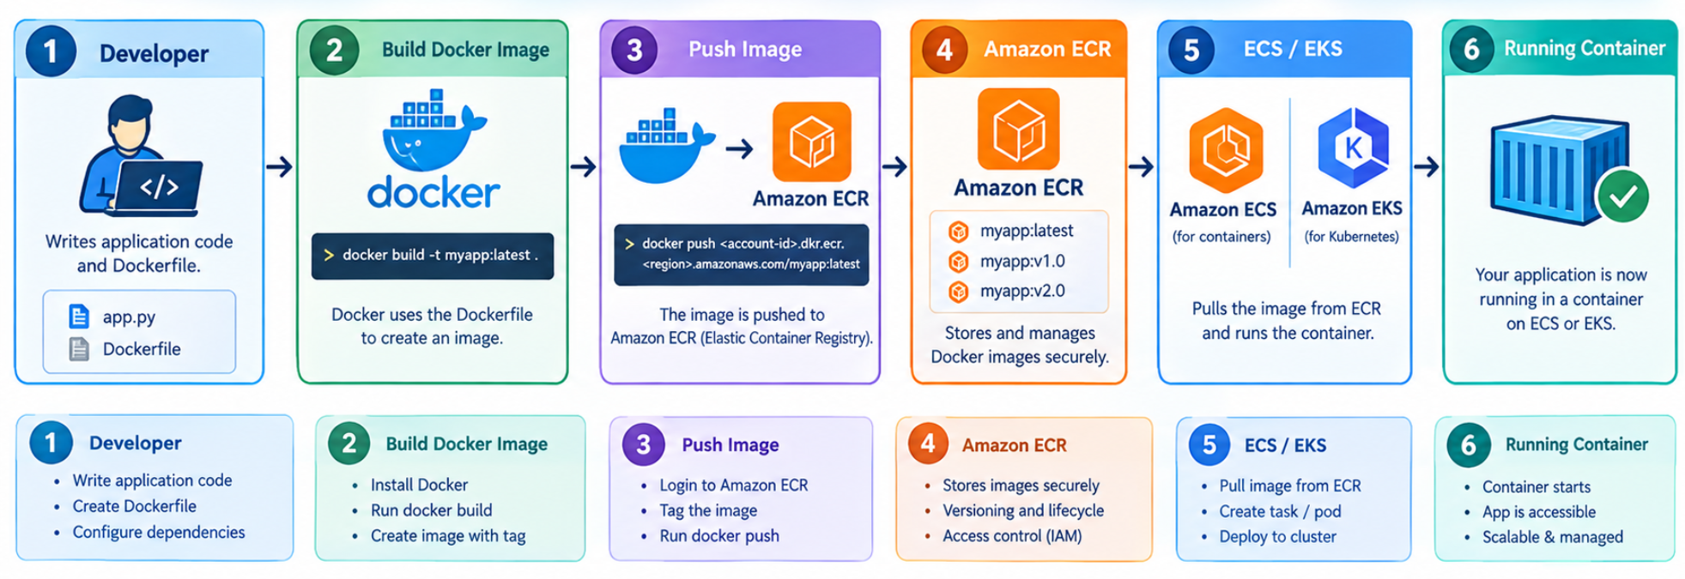
Container Deployment Using ECR
Key Point: build, push, run.
93

Slide 93
ECR Features
Feature | What it does
Repositories | One repository per application, holding many tagged images
Tags | Version labels; tag immutability stops tags being overwritten
Image scanning | Finds known vulnerabilities (basic scanning, or enhanced scanning with Amazon Inspector)
Lifecycle policies | Delete old or untagged images automatically to save cost
Access control | IAM policies and repository policies, encryption at rest, cross-Region/account replication
94

Slide 94
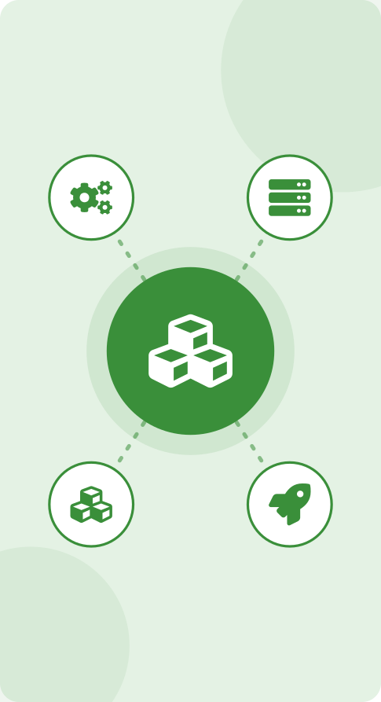
Part H
Amazon ECS
In this part
What Is Amazon ECS?
ECS Basic Architecture
Important ECS Concepts
ECS Launch Options
ECS with Fargate
ECS Example
95

Slide 95
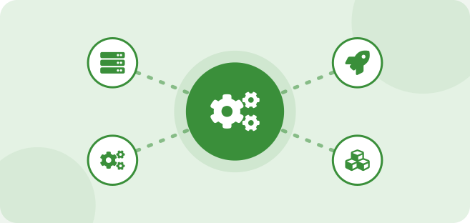
What Is Amazon ECS?
Elastic Container Service
AWS container orchestration service
Used to deploy and manage containers
Real-world scenario
The college website needs three copies of its container behind a load balancer, restarted automatically if one fails. ECS handles this.
Important for exam / interview
ECS is AWS-native and has no extra control-plane charge; you pay for EC2 or Fargate resources.
ECS integrates with ALB, IAM, CloudWatch, ECR and Auto Scaling.
96

Slide 96
ECS Basic Architecture: Diagram
Cluster = logical group; service = keeps N tasks running; task = running copy; task definition = blueprint
ECS Cluster
Users
Application Load Balancer
ECS Service
keeps the desired number of tasks running
Task 1
Task 2
Task 3
Tasks
each created from a Task Definition
Containers
97

Slide 97
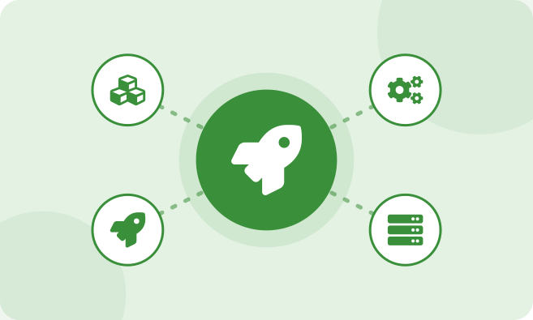
Important ECS Concepts
Cluster
Task
Task Definition
Service
Container
Important for exam / interview
Task execution role lets ECS pull from ECR and write logs; task role gives the application its own AWS permissions.
98

Slide 98
Important ECS Concepts
Fragment of a task definition.
Fragment of a task definition
{ "family": "college-web",
"requiresCompatibilities": ["FARGATE"],
"networkMode": "awsvpc", "cpu": "256", "memory": "512",
"containerDefinitions": [{
"name": "web",
"image": "<account-id>.dkr.ecr.<region>.amazonaws.com/college-web:1.0",
"portMappings": [{ "containerPort": 80 }],
"essential": true }] }
Key Point: The task definition is the blueprint: image, CPU, memory, ports and launch type.
99

Slide 99
Important ECS Concepts
Concept | Meaning
Cluster | Logical grouping of compute where tasks run
Task Definition | JSON blueprint: image, CPU, memory, ports, environment, roles, logging
Task | Running instantiation of a task definition
Service | Maintains desired task count, replaces failed tasks, attaches to a load balancer
Container | Process inside a task
100

Slide 100
ECS launch type: EC2 vs Fargate
Aspect | ECS on EC2 | ECS on Fargate
Servers | You manage EC2 instances (patching, scaling) | No servers to manage
Pricing | Pay for EC2 instances | Pay for vCPU and memory used by tasks
Control | Full control (GPU, custom AMI, daemon tasks) | Less control, simpler
Best for | Steady heavy workloads, special hardware | Simple, variable or small workloads
101

Slide 101
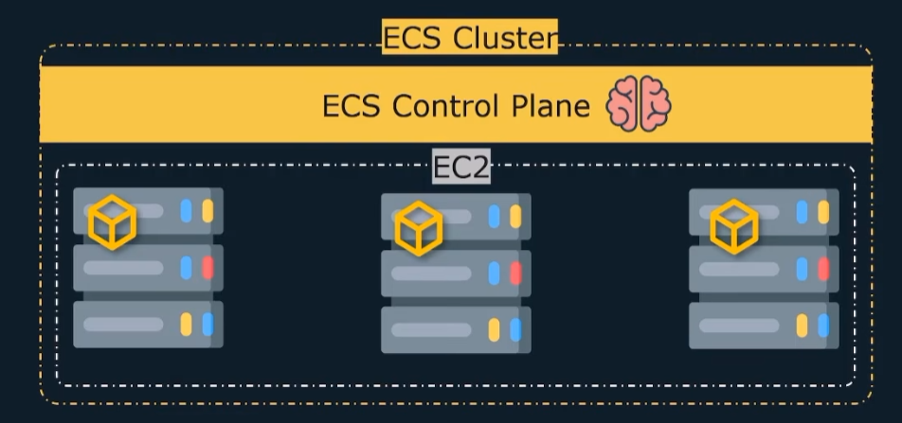
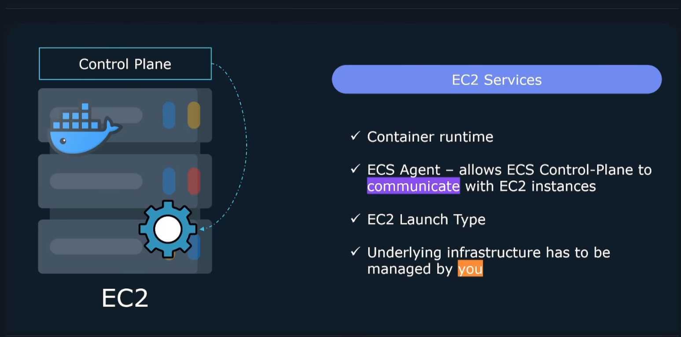
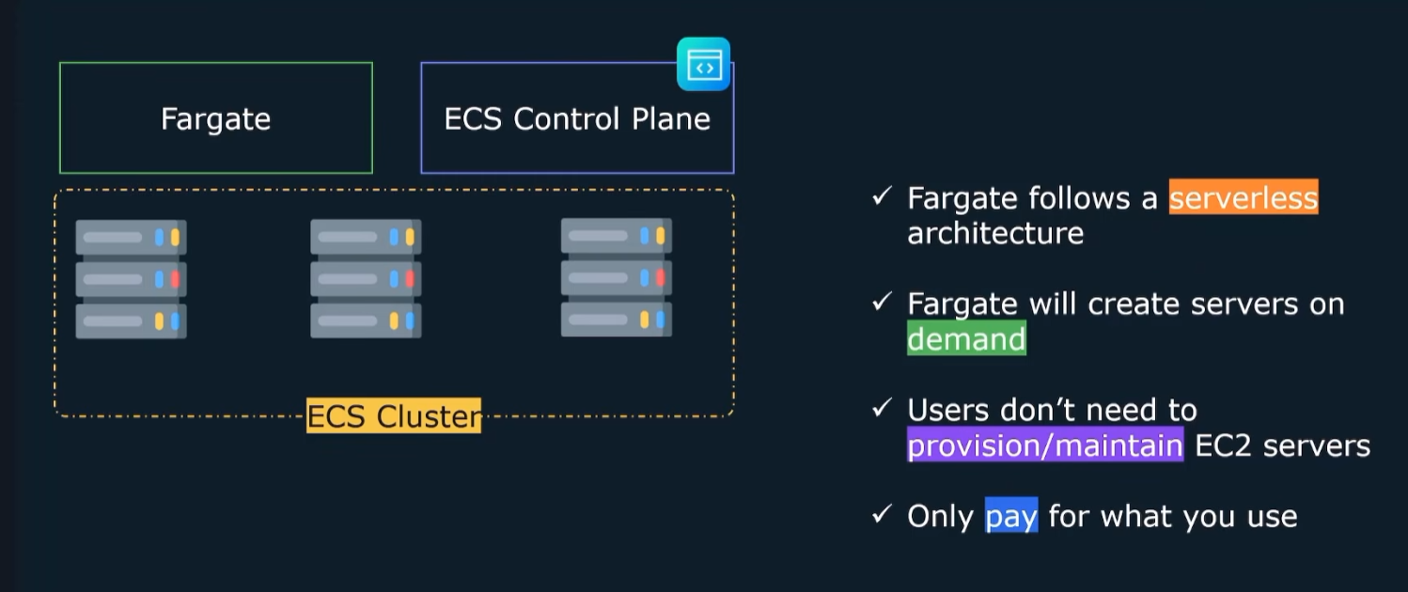

Slide 102
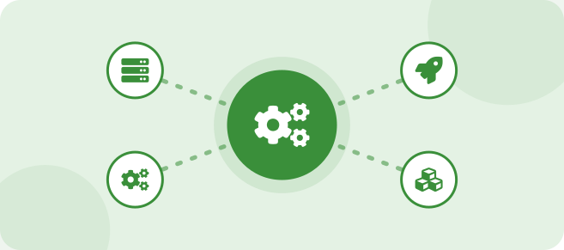
ECS with Fargate
Serverless container execution
AWS manages underlying infrastructure
User focuses on containers
Useful for simple container deployment
Real-world scenario
The college events website is busy only before festivals. On Fargate, the team pays only while tasks run and never patches servers.
Important for exam / interview
Each Fargate task gets its own network interface (awsvpc mode) and security group.
Choose CPU and memory per task from supported combinations.
103

Slide 103
ECS Example: Diagram
End-to-end deployment of the college website.
Developer
Dockerfile
Docker image
Amazon ECR
pull image
Users
Application Load Balancer
ECS Service
Fargate, 2 tasks
104

Slide 104
Role of Amazon ECS
Amazon ECR
Stores container images
CloudWatch
Logs and metrics
Amazon ECS
Orchestrates containers
Schedules tasks on Fargate or EC2
Keeps the desired number of tasks running
Replaces failed tasks
Rolls out new versions
Load balancer
Spreads traffic across tasks
Auto Scaling
Adds or removes tasks
IAM
Task roles and permissions
VPC
Private network, security groups
105
Notes:
Amazon ECS (Elastic Container Service) is AWS's container orchestration service. Its role is to deploy, run and manage containers at scale. It schedules tasks onto AWS Fargate or EC2 capacity, keeps the desired number of tasks running, replaces failed tasks and rolls out new versions. It works with other AWS services: Amazon ECR stores the container images, an Application Load Balancer distributes traffic across tasks, IAM task roles control permissions, CloudWatch collects logs and metrics, Application Auto Scaling adds or removes tasks, and the VPC provides private networking and security groups.

Slide 105
Running Containers on ECS
1
2
3
Build and push the image
Package the app with Docker and push the image to Amazon ECR.
Define the task
The task definition lists the image, CPU and memory, ports, environment and IAM roles.
Create a cluster
A logical group of capacity: Fargate, EC2 instances or both.
4
5
6
Create a service
Set the desired task count, subnets, security groups and an Application Load Balancer.
ECS places the tasks
The scheduler starts tasks on Fargate or EC2 and registers them with the load balancer.
ECS keeps them healthy
Health checks replace failed tasks and keep the desired count running.
106
Notes:
To run a containerized workload on ECS: 1) build the Docker image and push it to Amazon ECR; 2) create a task definition that lists the image, CPU and memory, ports, environment variables and IAM roles; 3) create a cluster, a logical group of capacity (Fargate, EC2 or both); 4) create a service with the desired task count, subnets, security groups and an Application Load Balancer; 5) the ECS scheduler places the tasks on Fargate or EC2 and registers them with the load balancer; 6) ECS monitors health checks, replaces failed tasks and keeps the desired count running.

Slide 106
Scaling Containers with ECS
Scale the tasks (service level)
Service Auto Scaling adds or removes tasks
Target tracking keeps CPU or requests per task near a set value
Step and scheduled scaling for big or predictable changes
The load balancer spreads traffic over all tasks
Scale the capacity (infrastructure)
Fargate: capacity is provided automatically per task
EC2: capacity providers and Auto Scaling groups add or remove instances
Mix On-Demand and Spot capacity to cut cost
Example: traffic spike on the results page
Normal load
3 tasks
Tasks are added as load rises and removed as it falls: the application stays responsive and you pay only for what runs.
Traffic spike
8 tasks
Load falls
3 tasks
107
Notes:
ECS scales containerized workloads at two levels. SERVICE (task) scaling: ECS Service Auto Scaling, through Application Auto Scaling, adds or removes tasks. Target tracking keeps a metric such as average CPU or requests per target near a set value; step scaling and scheduled scaling handle bigger or predictable changes. The load balancer spreads traffic across all running tasks. CAPACITY (infrastructure) scaling: with Fargate, capacity is provided automatically for each task; with the EC2 launch type, capacity providers and Auto Scaling groups add or remove instances; On-Demand and Spot capacity can be mixed to cut cost. In the example, the service runs 3 tasks normally, grows to 8 during a traffic spike and scales back to 3 when load falls, so the application stays responsive and you pay only for what runs.

Slide 107
Why ECS Is Important
Scalability
Service Auto Scaling and Fargate grow and shrink the number of tasks with demand.
Availability and self-healing
Health checks and multi-AZ placement; failed tasks are replaced automatically.
Operational simplicity
No control plane or cluster software to install; simpler to learn than Kubernetes.
Cost efficiency
Fargate per-task pricing, Spot capacity and right-sized tasks.
Security and integration
IAM task roles, VPC networking, Secrets Manager, CloudWatch and ECR.
Fast, safe deployments
Rolling updates, blue/green with CodeDeploy and automatic rollback.
Limitation: ECS is AWS-specific; choose EKS when portable Kubernetes is required.
108
Notes:
ECS matters for running containers on AWS because of: scalability (service auto scaling and Fargate capacity); availability and self-healing (health checks, multi-AZ placement and automatic replacement of failed tasks); operational simplicity (no Kubernetes control plane or cluster software to install, simpler to learn than EKS); cost efficiency (Fargate per-task pricing, Spot capacity and right-sized tasks); security and integration (IAM task roles, VPC networking, Secrets Manager, CloudWatch and ECR); and fast, safe deployments (rolling updates, blue/green with CodeDeploy and automatic rollback). The limitation is that ECS is AWS-specific; choose EKS when portable Kubernetes is required.

Slide 108

Part I
Amazon EKS
In this part
What Is Amazon EKS?
What Is Kubernetes?
Basic EKS Architecture
Important Kubernetes Concepts
ECS vs EKS
109

Slide 109

What Is Kubernetes?
Container orchestration platform
Automates:
Deployment
Scaling
Networking
Container management
Recovery
Important for exam / interview
Kubernetes is open source (originally from Google) and runs on any cloud or on premises.
Declarative model: describe the desired state in YAML; Kubernetes makes it happen.
110

Slide 110
What Is Kubernetes?: Diagram
Kubernetes continuously reconciles desired and actual state.
Kubernetes
You declare
Starts 3 pods; if one dies, starts another
"Run 3 copies of college-web"
If load rises (autoscaler), adds pods
Key Point: Kubernetes continuously reconciles desired and actual state.
111

Slide 111

What Is Amazon EKS?
Elastic Kubernetes Service
Managed Kubernetes service
Used to deploy and manage containers
Useful for large and complex container environments
Real-world scenario
A company already runs Kubernetes on premises and wants to move to AWS without rewriting its deployment files. EKS is the natural fit.
Important for exam / interview
AWS runs and patches the Kubernetes control plane across multiple AZs; you manage workloads and, depending on the option, worker nodes.
Worker options: managed node groups, self-managed nodes, Fargate; EKS Auto Mode automates more of the infrastructure.
EKS charges per cluster-hour for the control plane plus worker costs.
112

Slide 112

Why EKS?

Slide 113

Basic EKS Architecture
EKS
Kubernetes Control Plane
Worker Node
Pods
Containers
114
Notes:
CONSOLE STEPS
Install aws cli, kubectl and eksctl.
Create a cluster: eksctl create cluster --name college --region <region> --nodes 2
Update kubeconfig: aws eks update-kubeconfig --name college --region <region>
Verify: kubectl get nodes
Deploy: kubectl create deployment web --image=<ecr-image-uri> and kubectl expose deployment web --type=LoadBalancer --port=80
Delete when finished: eksctl delete cluster --name college
HANDS-ON LAB
Lab 7 - Create a small EKS cluster with eksctl, deploy the image, expose it and delete the cluster immediately. EKS is billed per hour.
TROUBLESHOOTING
kubectl cannot connect | kubeconfig not updated or IAM identity not authorised in the cluster | Run update-kubeconfig and check access entries / aws-auth mapping
Pod stuck Pending | No node capacity | kubectl describe pod; add nodes or reduce resource requests
ImagePullBackOff | Wrong image URI or node role lacks ECR access | Fix URI; attach ECR read permissions to the node role

Slide 114

Basic EKS Architecture: Diagram
Control plane managed by AWS; worker nodes run your pods.
Amazon EKS
Kubernetes control plane (managed by AWS)
Worker node
Worker node
Pods
Pods
Containers
Containers
115

Slide 115

Important Kubernetes Concepts
Cluster
Node
Pod
Deployment
Service
Namespace
Important for exam / interview
Pods are temporary; a Service gives them a stable address.
116

Slide 116
Important Kubernetes Concepts
Kubernetes Concept | Simple Meaning | ECS Comparison
Cluster | A group of machines that run your applications. | ECS Cluster
Node | A machine that runs your application containers. | EC2 Container Instance
Pod | A small unit that contains one or more containers. | ECS Task
Deployment | Ensures the required number of pods are running and manages updates. | ECS Service
Service | Provides a stable way to access pods, even if they change. | Load Balancer / Service Discovery
Namespace | Divides a cluster into separate environments or teams. | No direct equivalent
117

Slide 117




EKS Deployment Types:

Slide 118
Important Kubernetes Concepts: Diagram
Example Deployment manifest.
Example Deployment manifest
replicas: 3
apiVersion: apps/v1
kind: Deployment
metadata: { name: web }
spec:
replicas: 3
selector: { matchLabels: { app: web } }
template:
metadata: { labels: { app: web } }
spec:
containers:
- name: web
image: <ecr-image-uri>
ports: [{ containerPort: 80 }]
run three copies
matchLabels / labels
link the Deployment to its pods
image
comes from Amazon ECR
containerPort
the port the app listens on
119

Slide 119
ECS vs EKS
ECS - AWS container service, simpler to learn, AWS-specific
EKS - Managed Kubernetes, more complex, Kubernetes-based
Important for exam / interview
Exam: "Kubernetes" in the question -> EKS. "Simplest AWS-native container service" -> ECS (with Fargate).
Both can use EC2 or Fargate and pull from ECR.
120

Slide 120
ECS vs EKS
Point | Amazon ECS | Amazon EKS
Type | AWS-specific container service | Kubernetes-based container service
Learning | Easier to learn and use | Harder to learn; requires Kubernetes knowledge
Portability | Mainly designed for AWS | Can run across AWS, other cloud providers, and on-premises environments
Cost | No separate charge for the ECS control plane; pay for the infrastructure you use | AWS charges a cluster management fee, plus infrastructure costs
Tools and Support | Integrates easily with AWS services | Large ecosystem of tools, such as Helm and Argo CD
Best Used When | You want to run containers on AWS with less complexity | You need Kubernetes features, flexibility, or multi-cloud support
121

Slide 121

Part J
Container Deployment & Orchestration
In this part
Container Deployment Process
What Is Container Orchestration?
Why Do We Need Orchestration?
Container Scaling
Container Health Checks
122

Slide 122

Container Deployment Process
Application
Dockerfile
Docker Image
ECR
ECS / EKS
Running Container
Important for exam / interview
In production the steps are automated using CodePipeline/CodeBuild or GitHub Actions: commit -> build -> push -> deploy.
123

Slide 123
Container Deployment Process: Diagram
Standard pipeline; usually automated with CI/CD.
Docker build
Docker push
Pull and Deploy
Application code
Dockerfile
Docker image
ECR
ECS / EKS
Running container
Key Point: a standard pipeline, usually automated with CI/CD.
124

Slide 124

What Is Container Orchestration?
Managing many containers
Starting/stopping containers
Scaling
Load balancing
Health monitoring
Restarting failed containers
Important for exam / interview
Orchestrators on AWS: ECS and EKS (Kubernetes).
Orchestration = scheduling + scaling + networking + self-healing.
125

Slide 125

Why Do We Need Orchestration?
Imagine an application with:
1 Container -> Easy to manage
100 Containers -> Difficult manually
Orchestration automates the management of these containers.
Real-world scenario
At 2 a.m. a node fails and 20 containers stop. Without orchestration somebody must wake up and restart them; with ECS or Kubernetes they restart on healthy nodes automatically.
Important for exam / interview
Think of an orchestrator as a traffic controller for containers.
126

Slide 126

Container Scaling
Vertical scaling
Give a container/task more CPU and memory
Horizontal scaling
Run more copies of the container
Adding more container instances
Service desired count goes up
Auto Scaling concept
Scale automatically based on metrics
Important for exam / interview
Prefer horizontal scaling for stateless containers.
Scale the containers and the underlying nodes (unless using Fargate).
127

Slide 127

Container Scaling
Platform | How it scales
ECS service | Application Auto Scaling: target tracking on CPU, memory or ALB requests per target
EKS pods | Horizontal Pod Autoscaler
EKS nodes | Cluster Autoscaler
ECS on EC2 capacity | Capacity providers with Auto Scaling groups
128

Slide 128

Container Health Checks
Where | Check
Dockerfile | HEALTHCHECK instruction
ECS task definition | Container health check command
Application Load Balancer | Target group health check path, interval, thresholds
Kubernetes | Liveness probe (restart) and readiness probe (receive traffic)
129

Slide 129

Part K
Container Best Practices
In this part
Container Best Practices
Container Security
Container Monitoring
130

Slide 130
Container Best Practices
Practice | Simple explanation | Example
Small images | Keep the Docker image small so it downloads and starts faster. | Use Alpine or Slim images instead of large base images.
Trusted bases | Use safe, official images from trusted sources. | Use an official Python image with a specific version.
No secrets in images | Never store passwords, API keys, or tokens inside an image. | Fetch secrets from AWS Secrets Manager when the application runs.
Updates | Regularly update your image to fix security problems. | Rebuild your image with updated OS packages.
Scanning | Check images for known security vulnerabilities. | Enable vulnerability scanning in AWS ECR.
Least privilege | Give the application only the permissions it needs. | Run the container as a non-root user and give it limited AWS IAM permissions.
131

Slide 131
Container Security
Area | AWS tools
Images | ECR scanning, immutable tags, private repos
IAM | Task roles (ECS), IAM roles for service accounts or Pod Identity (EKS); least-privilege pull roles for ECR
Network | Security groups per task, private subnets, VPC endpoints
Secrets | Secrets Manager, Parameter Store referenced in task definitions
Threat detection | GuardDuty, Inspector
132

Slide 132

Container Monitoring
Need | AWS service
Logs | CloudWatch Logs (awslogs driver) or FireLens
CPU, memory, network | CloudWatch Container Insights
Alarms | CloudWatch Alarms and SNS
Request tracing | AWS X-Ray
Audit | CloudTrail
133

Slide 133

Part L
Real-World Architecture
In this part
Complete AWS Application Architecture
Example: E-Commerce Application
Important Comparisons
Quick Revision
Practical/Lab Ideas
Unit 4: Key Takeaways
134

Slide 134
AWS Application Architecture: Diagram
Production-style three-tier architecture.
RDS (Multi-AZ)
standby in a second AZ
Users
Load Balancer
ECS / EKS
public subnets, multiple AZs
private subnets
pulls images
ElastiCache
Amazon ECR
135

Slide 135

Example: E-Commerce Application
Users browse products
Application runs in containers
Product/order data stored in database
Cache stores frequently accessed products
ECR stores application images
ECS/EKS manages containers
Real-world scenario
On sale day, containers scale from 4 to 40, the cache absorbs product views and the RDS primary handles only orders.
136

Slide 136
Example: E-Commerce Application: Diagram
Which service handles which job.
ElastiCache
hot products
Containers (ECS / EKS)
Browse
ALB
ECR holds the images
RDS
orders, payments
DynamoDB
shopping carts (optional)
137

Slide 137

Example: E-Commerce Application
Requirement | Service
Product pages load quickly | ElastiCache
Orders and payments must be consistent | RDS Multi-AZ
Shopping carts at massive scale (optional) | DynamoDB
Handle a flash sale | ECS/EKS auto scaling
Release new version | New image in ECR, rolling update
138

Slide 138

Important Comparisons
RDS vs DynamoDB
Multi-AZ vs Read Replica
DAX vs ElastiCache
ECS vs EKS
EC2 vs Fargate
Virtual Machine vs Container
Important for exam / interview
Prepare a one-sentence difference for each pair; these are common viva and interview questions.
139

Slide 139
Master comparison
Pair | Key difference
RDS vs DynamoDB | Relational SQL on instances vs serverless NoSQL by key
Multi-AZ vs Read Replica | Availability (sync, failover) vs read scaling (async)
DAX vs ElastiCache | DynamoDB-only cache vs general cache (Redis/Valkey/Memcached)
ECS vs EKS | AWS-native and simpler vs Kubernetes and portable
EC2 vs Fargate | You manage servers vs serverless containers
VM vs Container | Full OS per VM vs shared kernel, lightweight
140

Slide 140
Quick Revision
Service | One-liner | Key words
RDS | Managed SQL database | Multi-AZ, read replica, backups, endpoint
DynamoDB | Serverless NoSQL | Partition key, GSI, on-demand, ms latency
DAX | Cache for DynamoDB | Microseconds, write-through
ElastiCache | In-memory cache | Redis/Valkey, Memcached, TTL
ECR | Image registry | Push, pull, scan, tags
ECS | AWS orchestrator | Cluster, task definition, service, Fargate
EKS | Managed Kubernetes | Control plane, nodes, pods, kubectl
141

Slide 141
Lab plan
Lab | Objective | Output | Clean-up
1 | Create RDS MySQL and connect from EC2 | Students table with rows | Delete DB, skip final snapshot
2 | Enable Multi-AZ, failover test, read replica | Failover time noted | Delete replica and DB
3 | Create DynamoDB table and a GSI | Query by StudentID and Course | Delete table
4 | Build and run a Docker container locally | Web page on port 8080 | Remove container and image
5 | Push the image to ECR | Image visible with tag | Delete repository
6 | Deploy on ECS Fargate behind ALB | Site opens via ALB DNS | Delete service, cluster, ALB
7 | Create small EKS cluster, deploy app | kubectl get pods output | eksctl delete cluster
142

Slide 142
Self-check: viva and interview questions
Question | Short answer
Multi-AZ or read replica to survive an AZ failure? | Multi-AZ (synchronous standby, automatic failover)
Why is a read replica not a backup? | Asynchronous copy of live data; deletes are replicated
How do you make a DynamoDB table searchable by another attribute? | Add a Global Secondary Index
What is the difference between an image and a container? | Image is the template; container is a running instance
How does a container image get from developer to production? | Dockerfile, build, push to ECR, deploy on ECS/EKS
When choose EKS over ECS? | When Kubernetes skills or portability are required
What does Fargate remove? | Management of servers/nodes
Which service speeds up DynamoDB reads? | DAX
143

